Slide 1
Chapter 8: Subnetting IP Networks
Introduction to Networks
Notes:
Cisco Networking Academy program
Introduction to Networks
Chapter 7: Subnetting IP Networks

Slide 2
Chapter Outline
6.0 Introduction
6.1 Subnetting an IPv4 Network
6.2 Addressing Schemes
6.3 Summary

Slide 3
Section 8.1: Subnetting an IPv4 Network
Upon completion of this section, you should be able to:
Explain how subnetting segments a network to enable better communication.
Explain how to calculate IPv4 subnets for a /24 prefix.
Explain how to calculate IPv4 subnets for a /16 and /8 prefix.
Given a set of requirements for subnetting, implement an IPv4 addressing scheme.
Explain how to create a flexible addressing scheme using variable length subnet masking (VLSM).

Slide 4
Topic 8.1.1: Network Segmentation

Slide 5
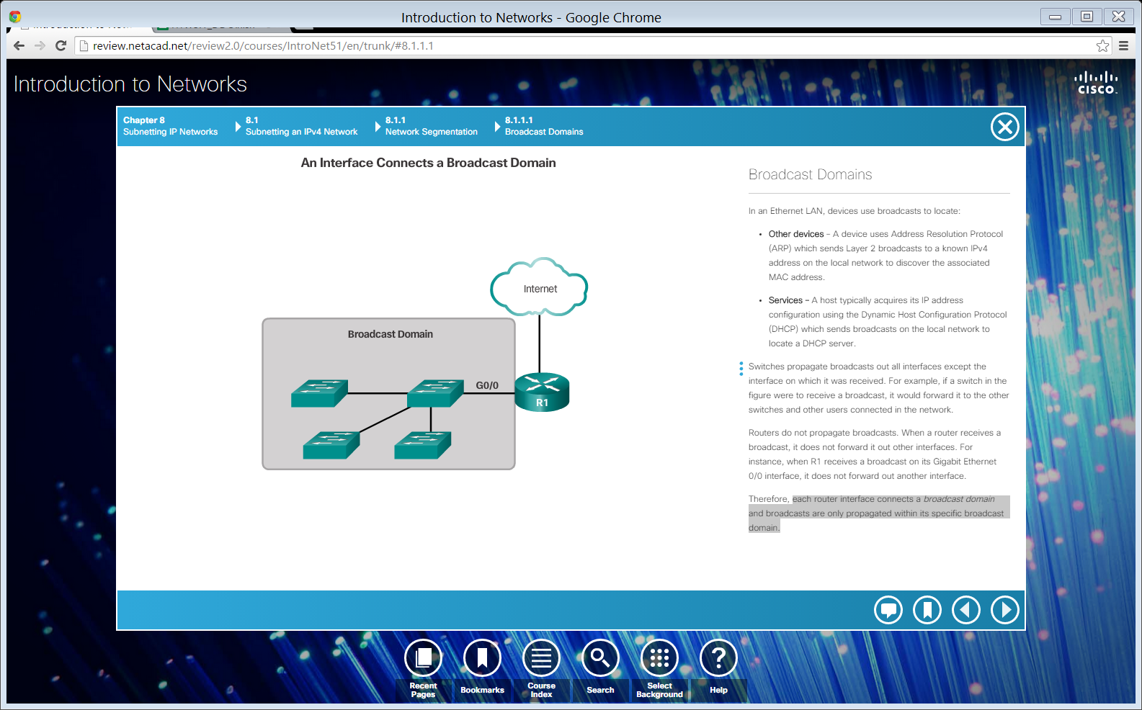
Broadcast Domains
Each router interface connects a broadcast domain and broadcasts are only propagated within its specific broadcast domain.
Notes:
8.1.1.1 Broadcast Domains

Slide 6
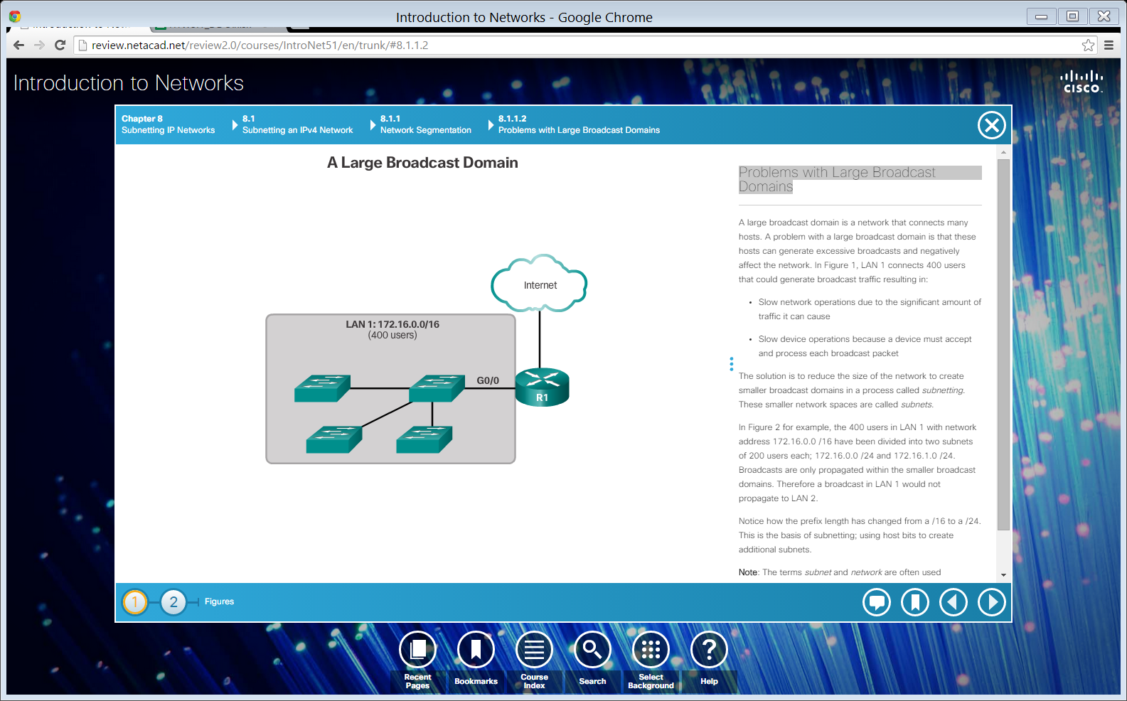
Problems with Large Broadcast Domains
Slow network operations due to the significant amount of broadcast traffic.
Slow device operations because a device must accept and process each broadcast packet.
Notes:
8.1.1.2 Problems with Large Broadcast Domains

Slide 7
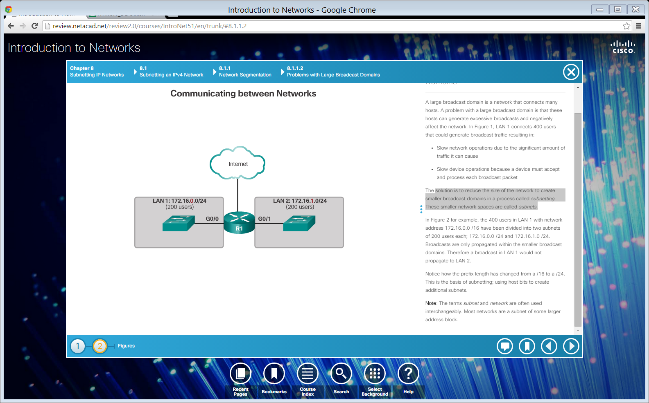
Problems with Large Broadcast Domains (cont.)
Solution -reduce the size of the network to create smaller broadcast domains in a process called subnetting.
These smaller network spaces are called subnets.
Notes:
8.1.1.2 Problems with Large Broadcast Domains (Cont.)

Slide 8
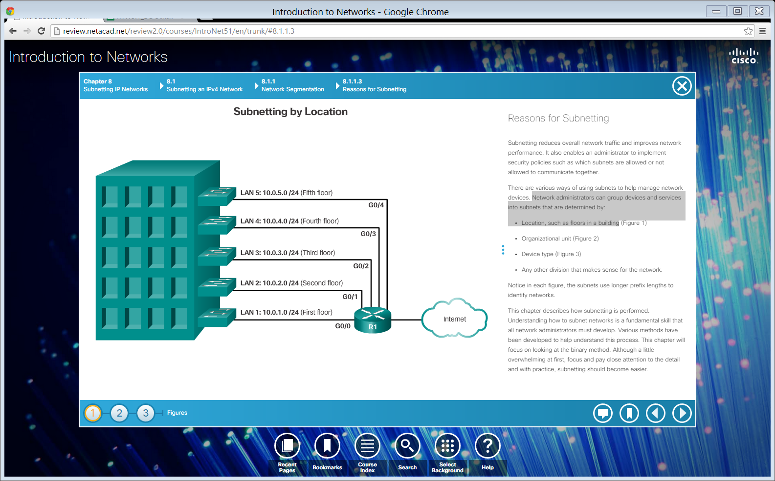
Reasons for Subnetting
Network administrators can group devices and services into subnets that are determined by: Location
Notes:
8.1.1.3 Reasons for Subnetting

Slide 9
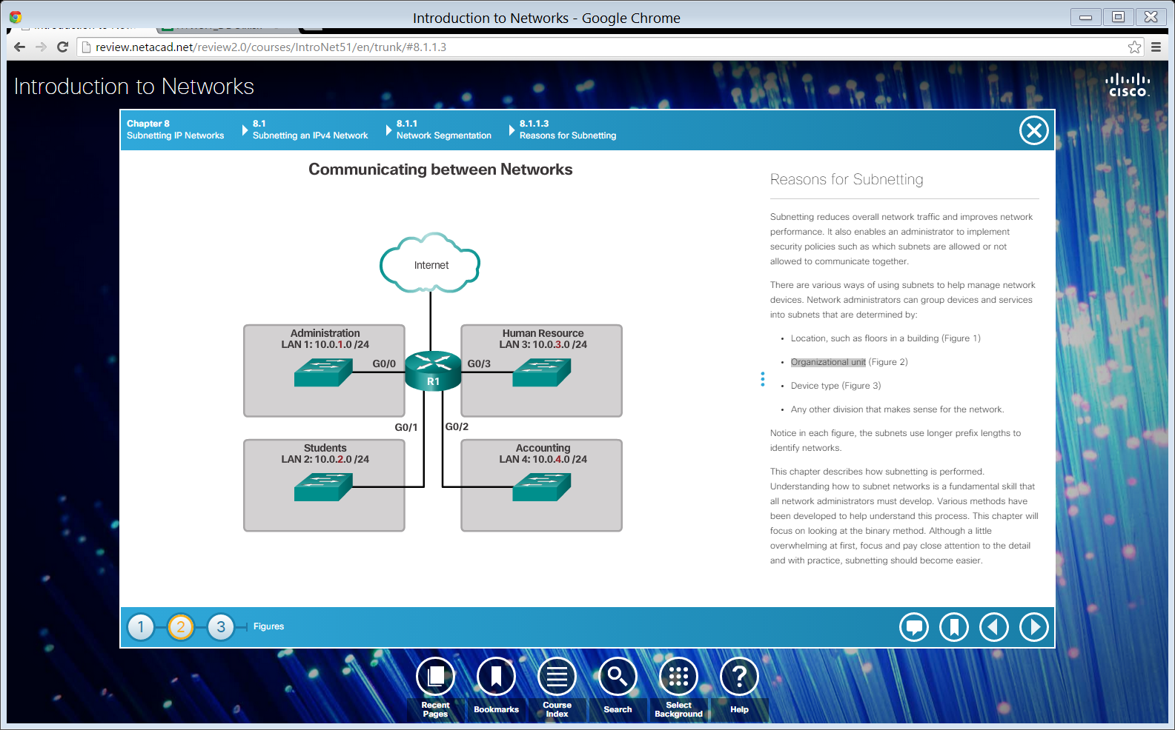
Reasons for Subnetting (cont.)
Network administrators can group devices and services into subnets that are determined by: Organizational unit.
Notes:
8.1.1.3 Reasons for Subnetting (Cont.)

Slide 10
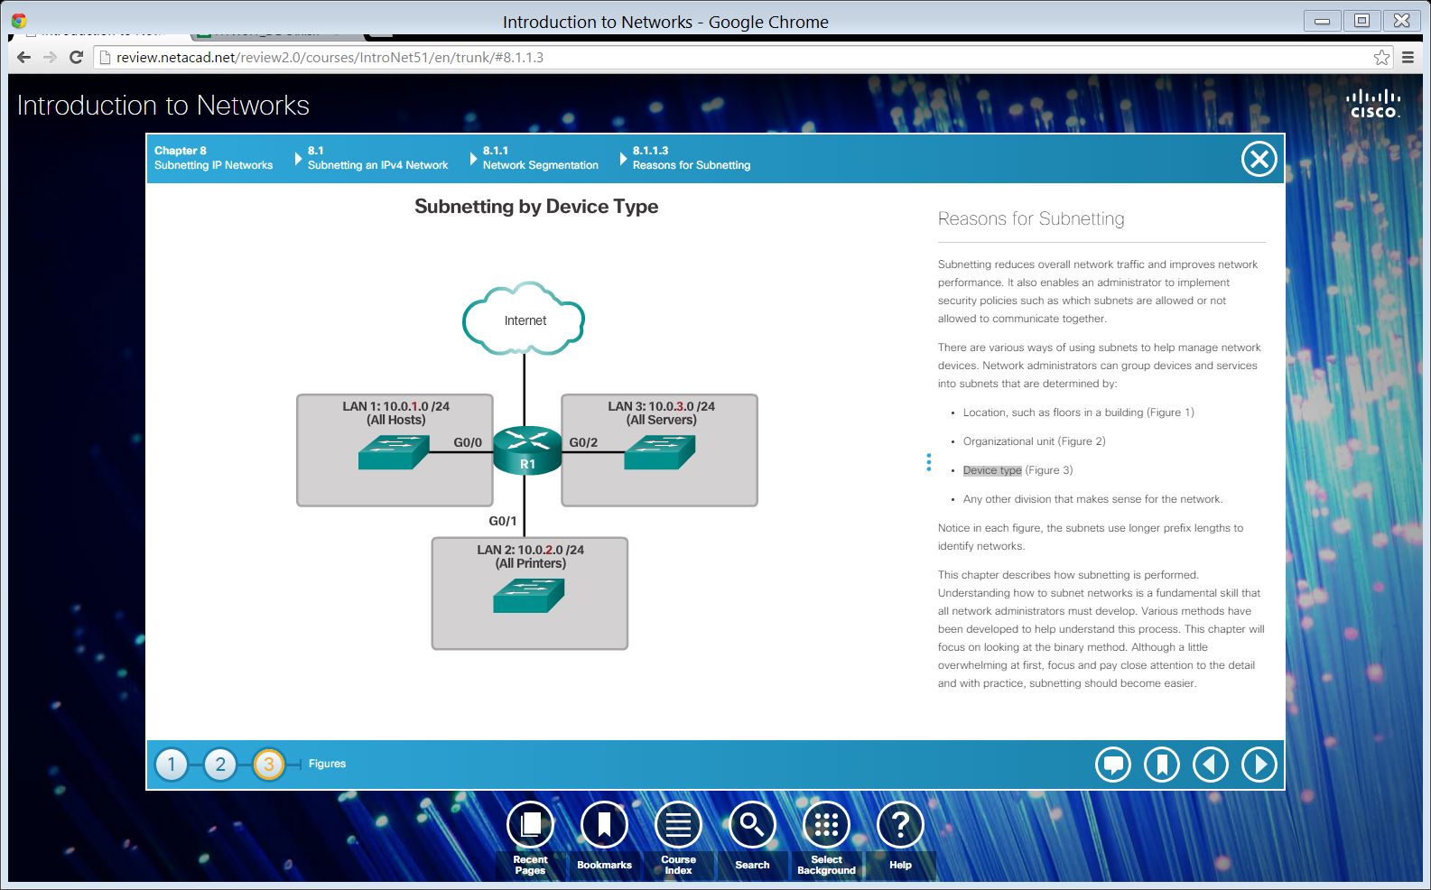
Reasons for Subnetting (cont.)
Network administrators can group devices and services into subnets that are determined by: Device type.
Notes:
8.1.1.3 Reasons for Subnetting (Cont.)

Slide 11
Topic 8.1.2: Subnetting an IPv4 Network

Slide 12
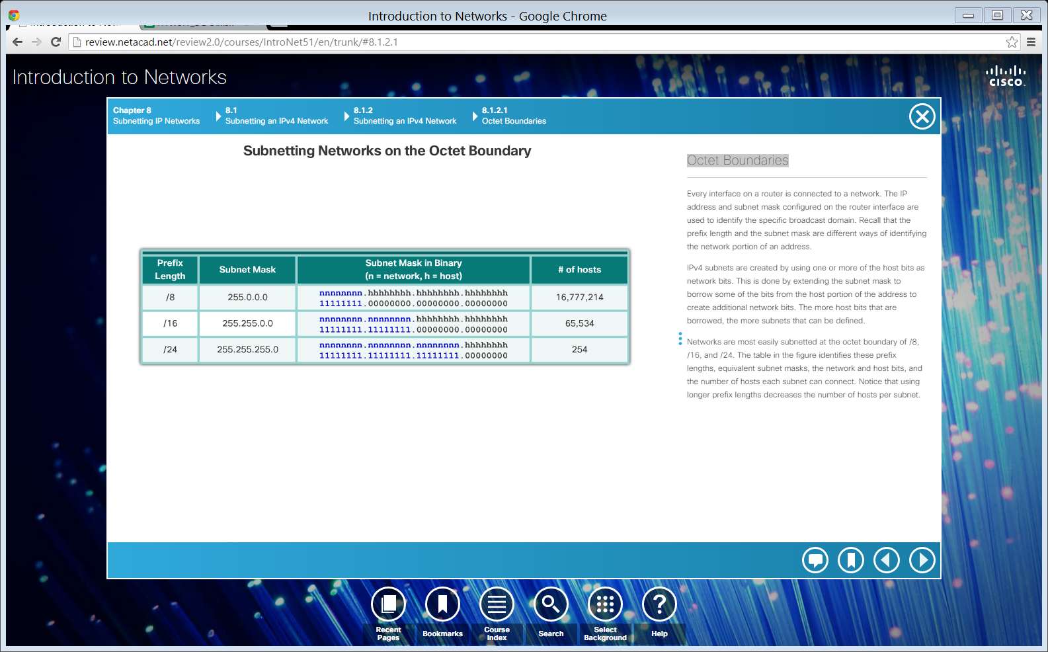
Octet Boundaries
Notes:
8.1.2.1 Octet Boundaries

Slide 13
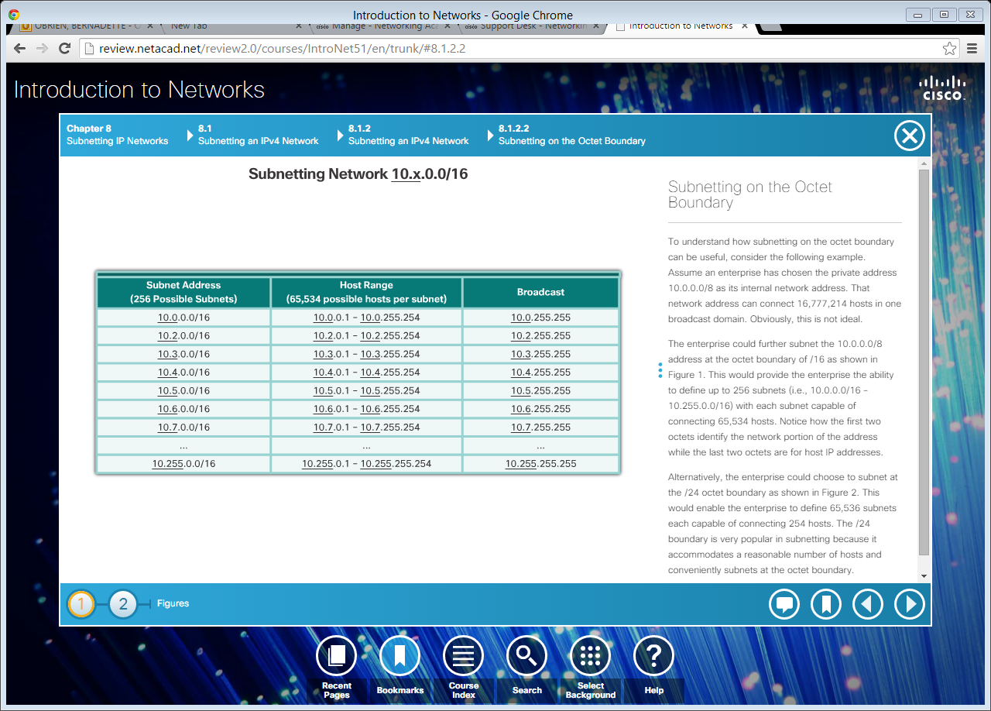
Subnetting on the Octet Boundary
Subnetting 10.x.0.0/16
Notes:
8.1.2.2 Subnetting on the Octet Boundary

Slide 14
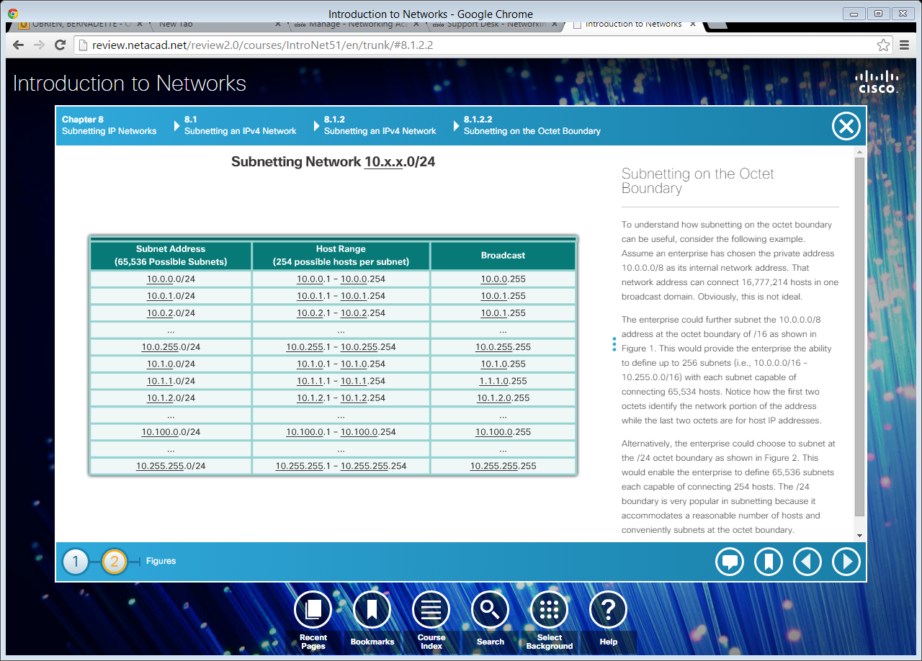
Subnetting on the Octet Boundary
Subnetting 10.x.x.0/24
Notes:
8.1.2.2 Subnetting on the Octet Boundary

Slide 15
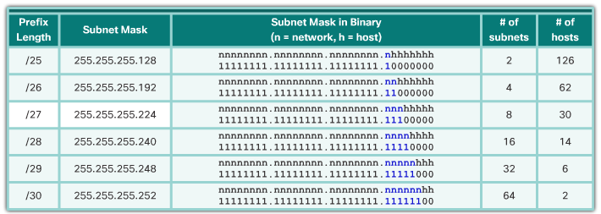
Classless Subnetting
/25 – Borrowing 1 bit from the fourth octet creates 2 subnets supporting 126 hosts each.
/26 – Borrowing 2 bits creates 4 subnets supporting 62 hosts each.
/27– Borrowing 3 bits creates 8 subnets supporting 30 hosts each.
/28 – Borrowing 4 bits creates 16 subnets supporting 14 hosts each.
/29 – Borrowing 5 bits creates 32 subnets supporting 6 hosts each.
/30– Borrowing 6 bits creates 64 subnets supporting 2 hosts each.
Notes:
8.1.2.3 Classless Subnetting
8.1.2.4 Video Demonstration – The Subnet Mask
8.1.2.5 Video Demonstration – Subnetting with the Magic Number

Slide 16
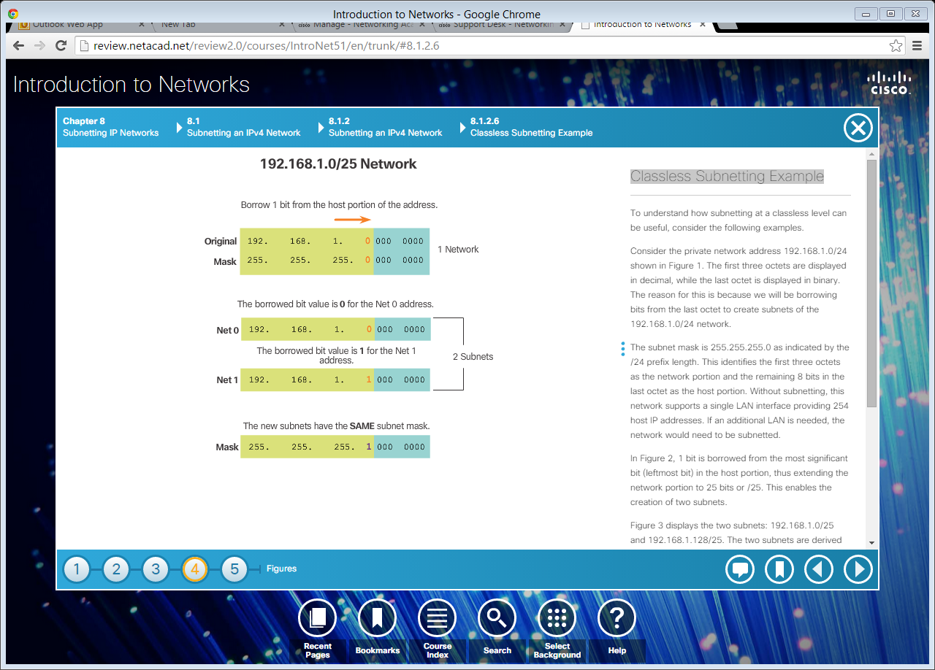
Classless Subnetting Example
Notes:
8.1.2.6 Classless Subnetting Example

Slide 17
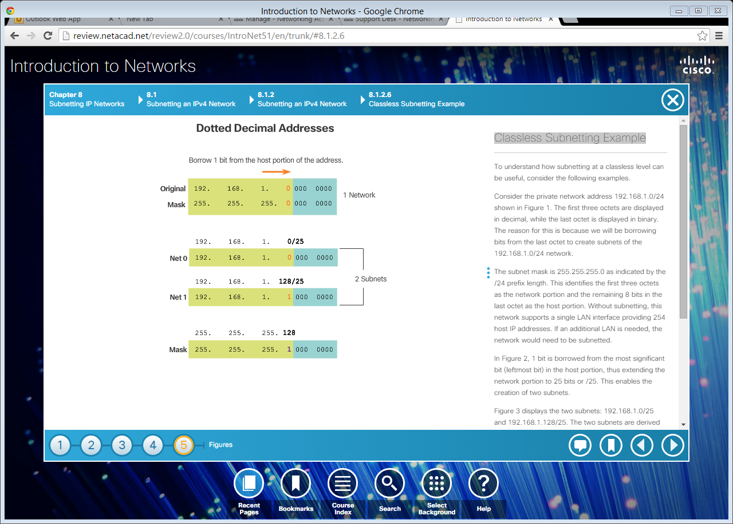
Classless Subnetting Example (cont.)
Notes:
8.1.2.6 Classless Subnetting Example (Cont.)

Slide 18
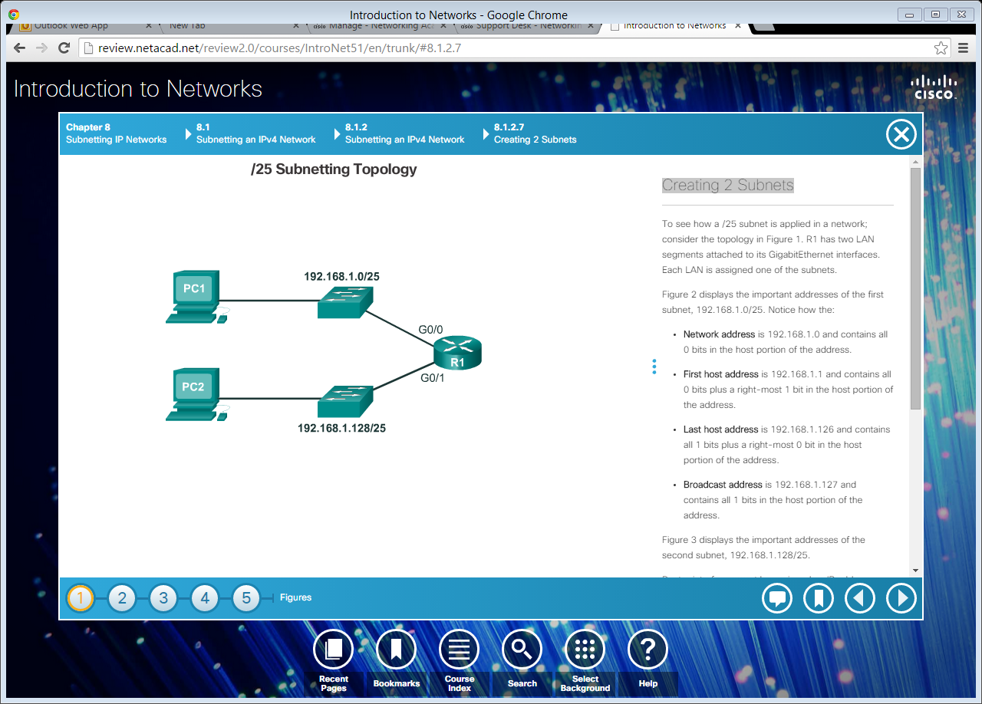
Creating 2 Subnets
Notes:
8.1.2.7 Creating 2 Subnets

Slide 19
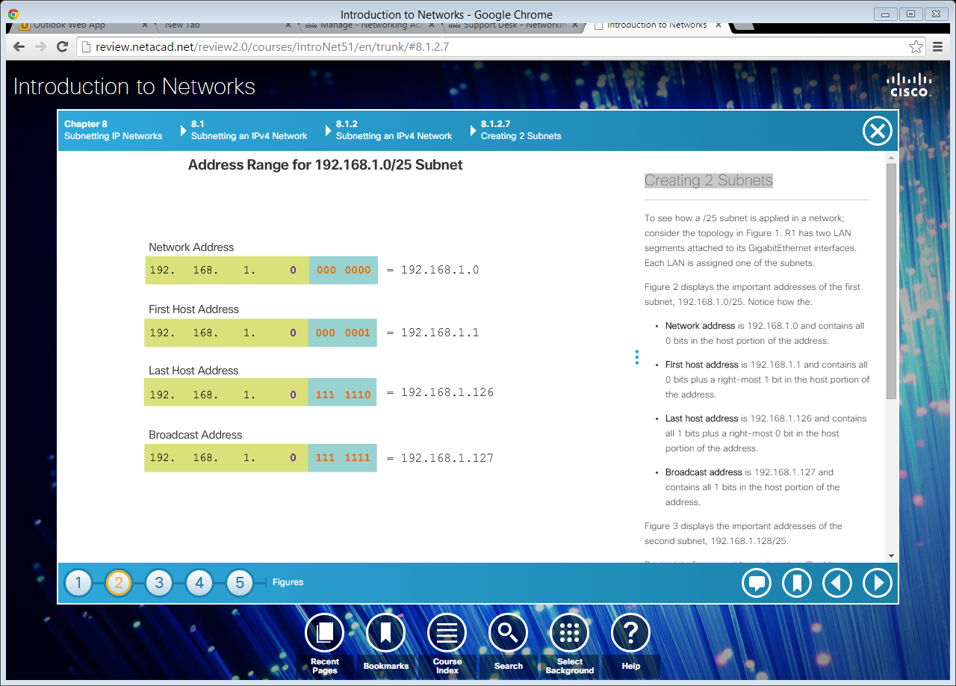

Creating 2 Subnets (cont.)
Notes:
8.1.2.7 Creating 2 Subnets (Cont.)

Slide 20
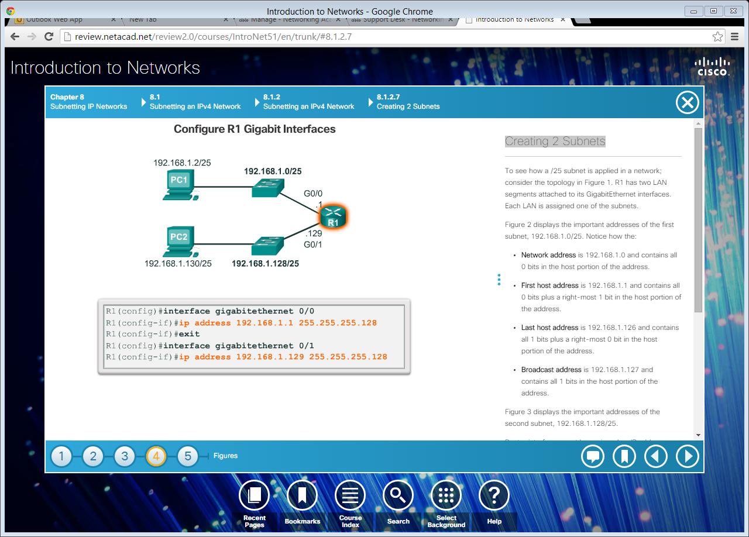
Creating 2 Subnets (cont.)
Notes:
8.1.2.7 Creating 2 Subnets (Cont.)

Slide 21
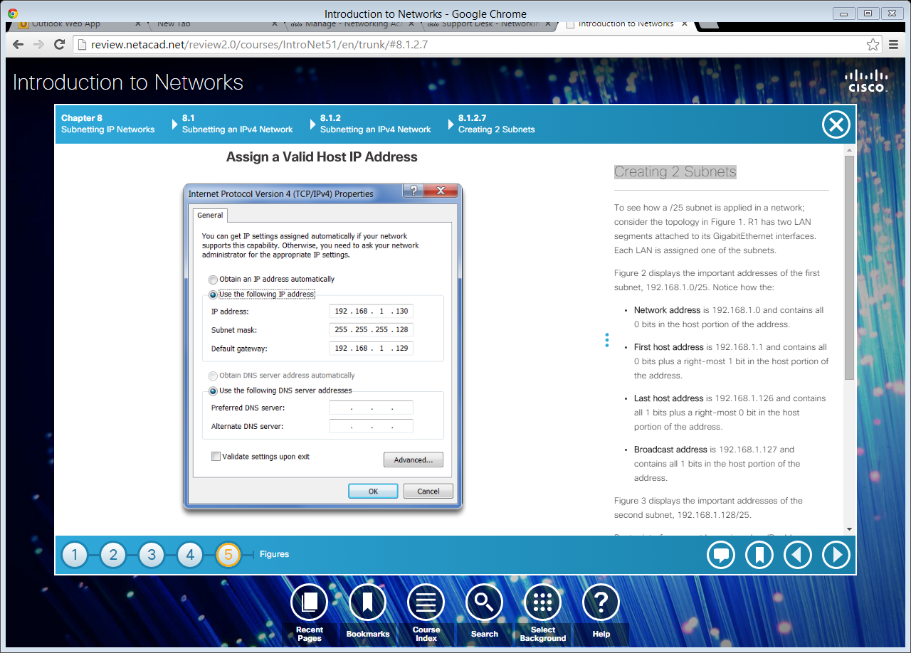
Creating 2 Subnets (cont.)
Notes:
8.1.2.7 Creating 2 Subnets (Cont.)
8.1.2.8 Video Demonstration – Creating Two Equal-Sized Subnets

Slide 22
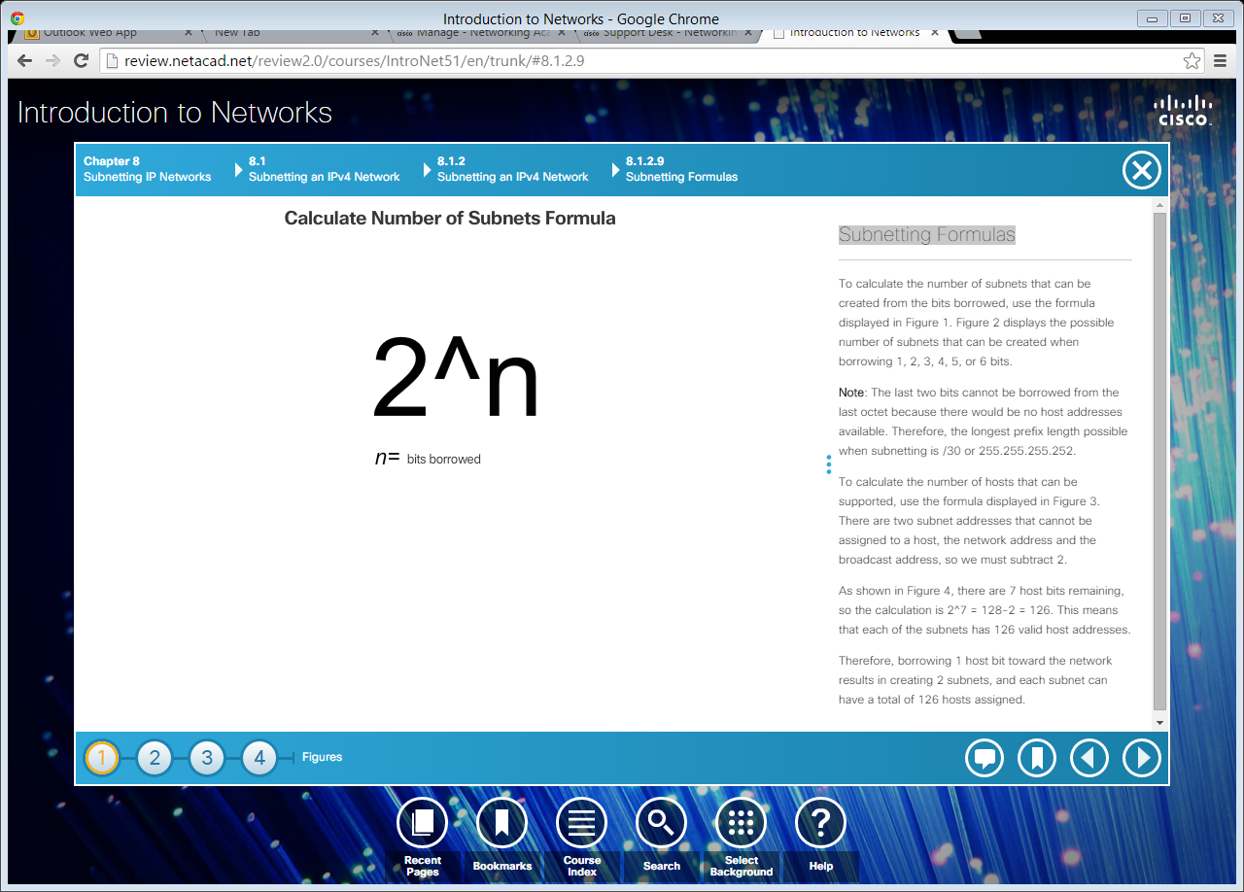
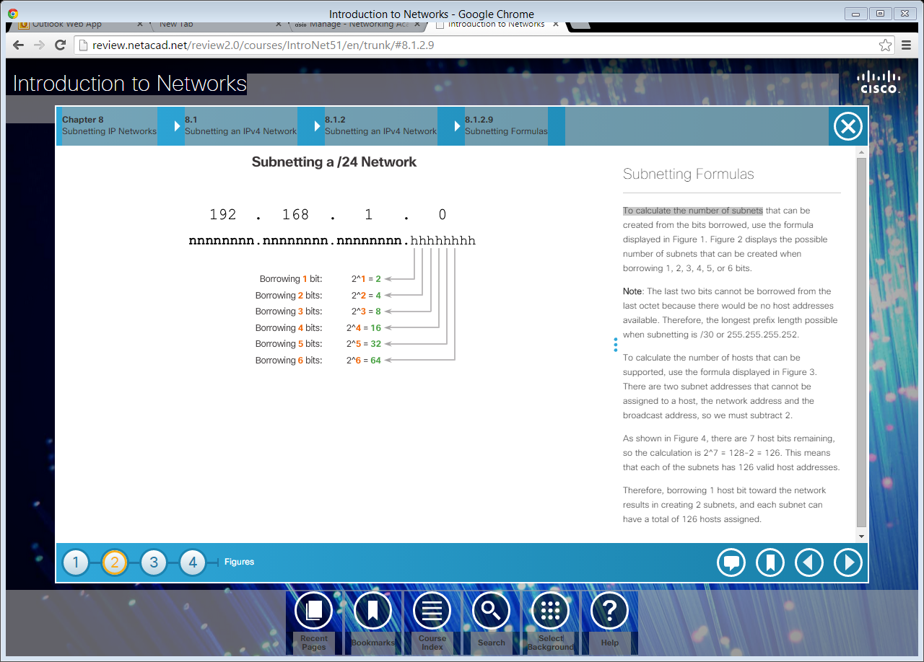
Subnetting Formulas
To calculate the number of subnets.
Notes:
8.1.2.9 Subnetting Formulas

Slide 23
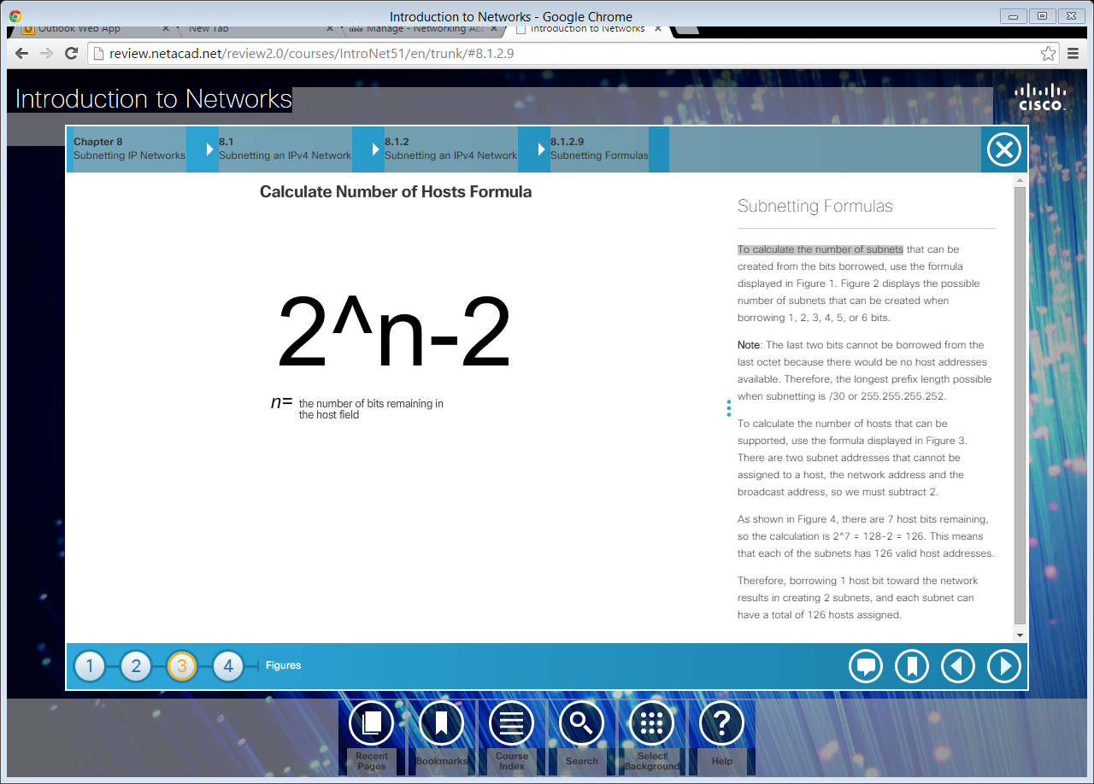
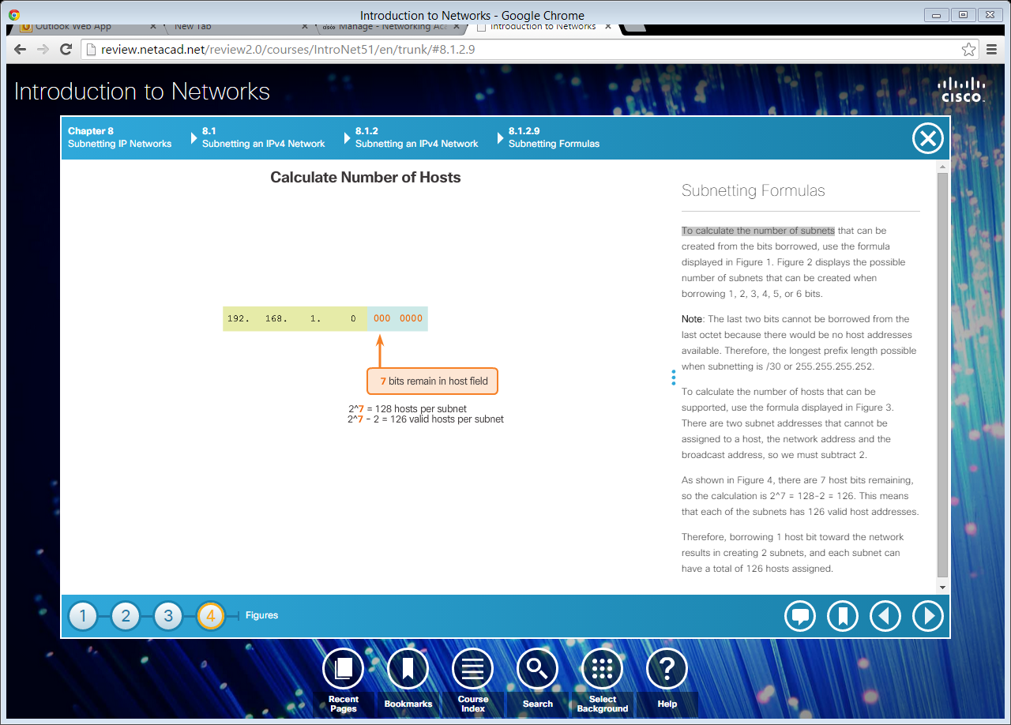
Subnetting Formulas (cont.)
To calculate the number of hosts.
Notes:
8.1.2.9 Subnetting Formulas (Cont.)

Slide 24
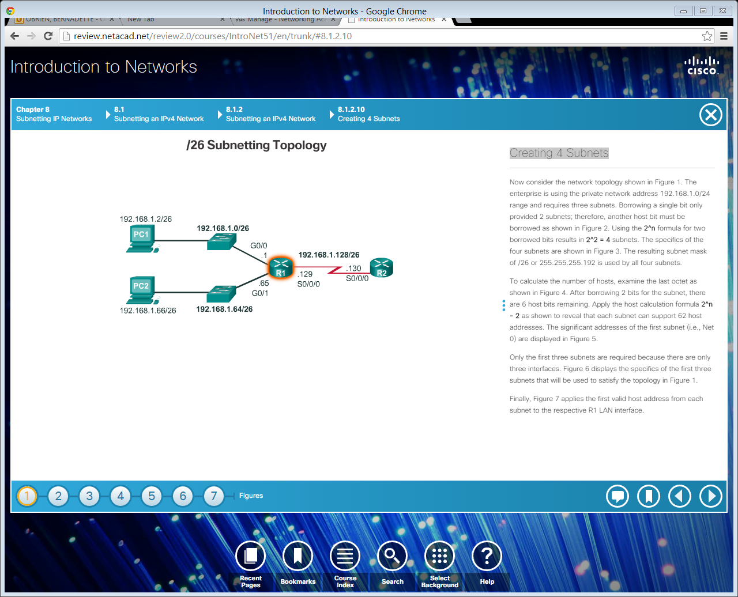
Creating 4 Subnets
Notes:
8.1.2.10 Creating 4 Subnets

Slide 25
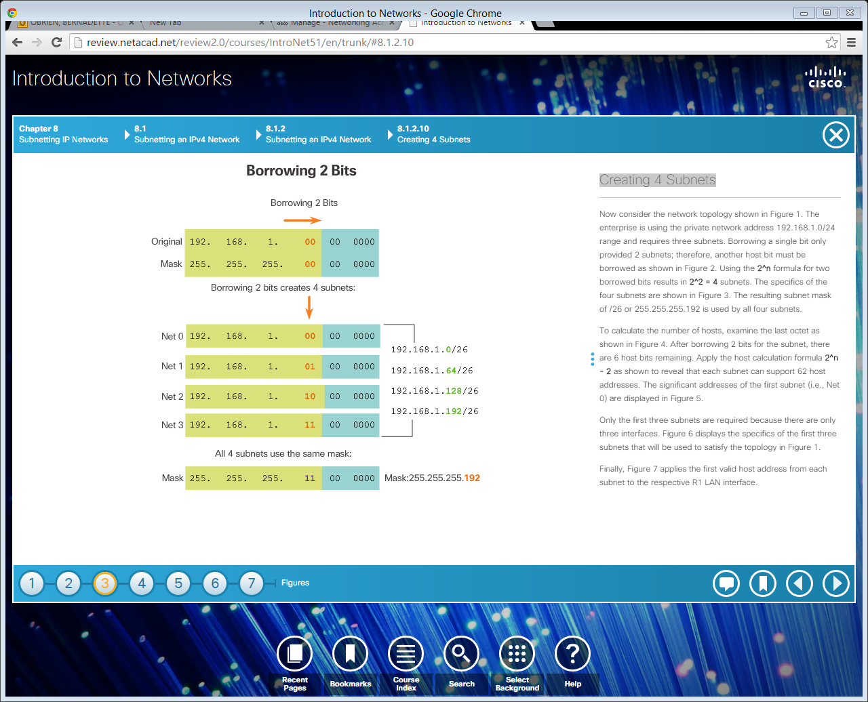
Creating 4 Subnets (cont.)
Notes:
8.1.2.10 Creating 4 Subnets (Cont.)

Slide 26
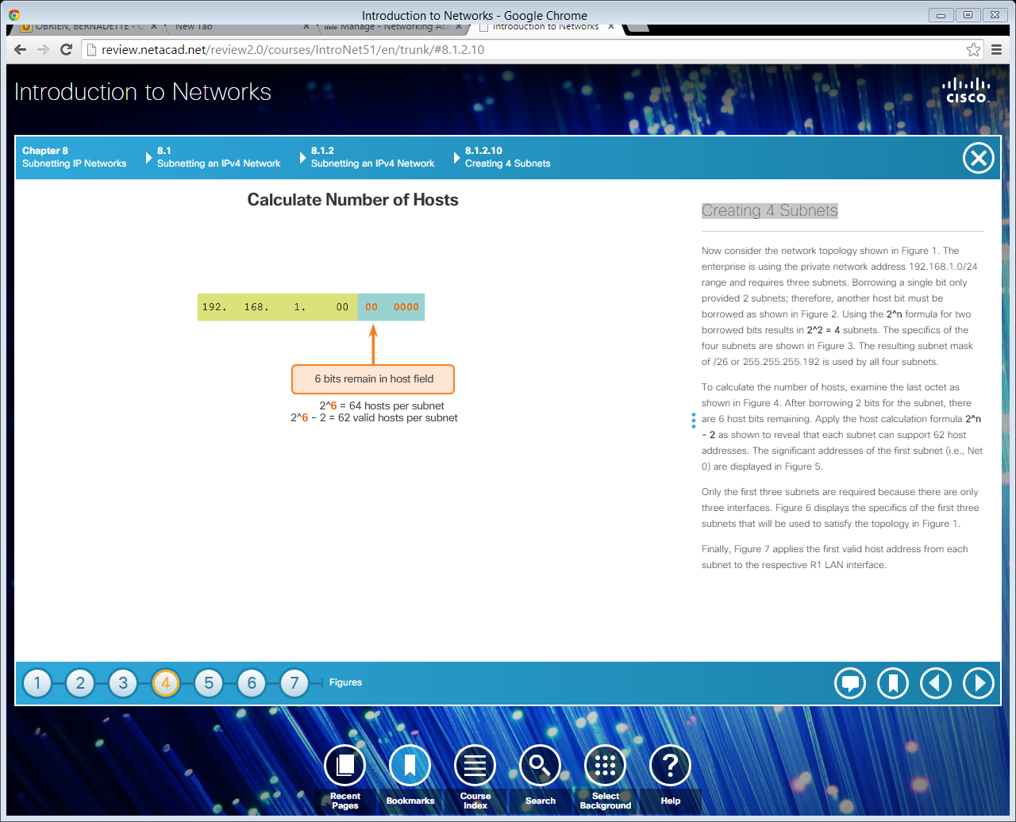
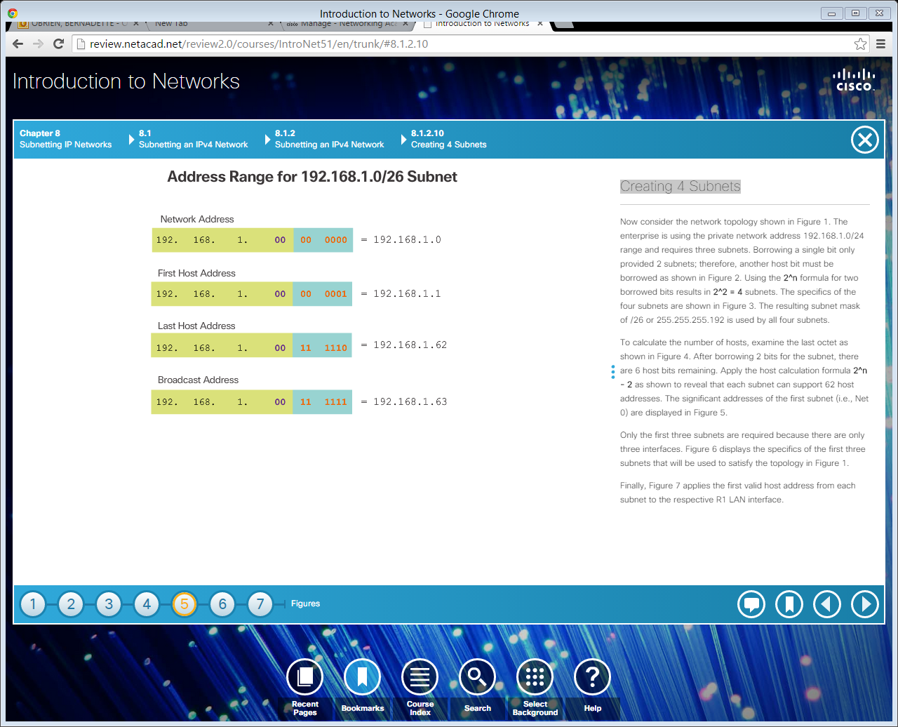
Creating 4 Subnets (cont.)
Notes:
8.1.2.10 Creating 4 Subnets (Cont.)

Slide 27
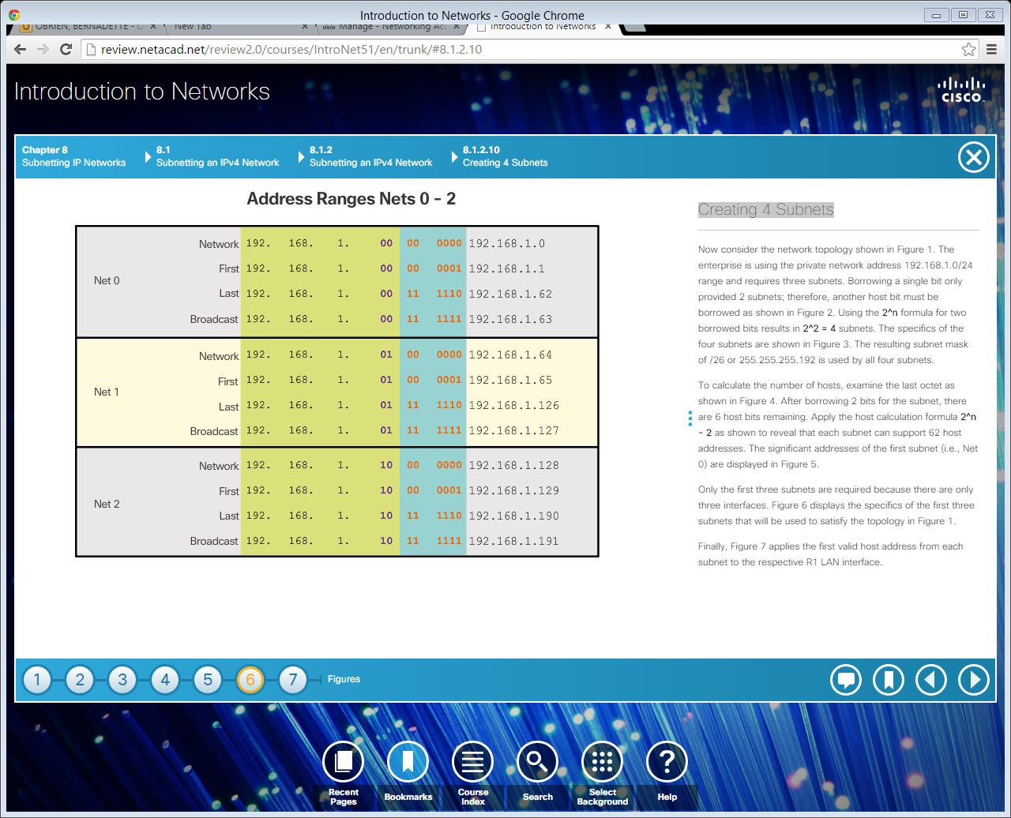
Creating 4 Subnets (cont.)
Notes:
8.1.2.10 Creating 4 Subnets (Cont.)

Slide 28
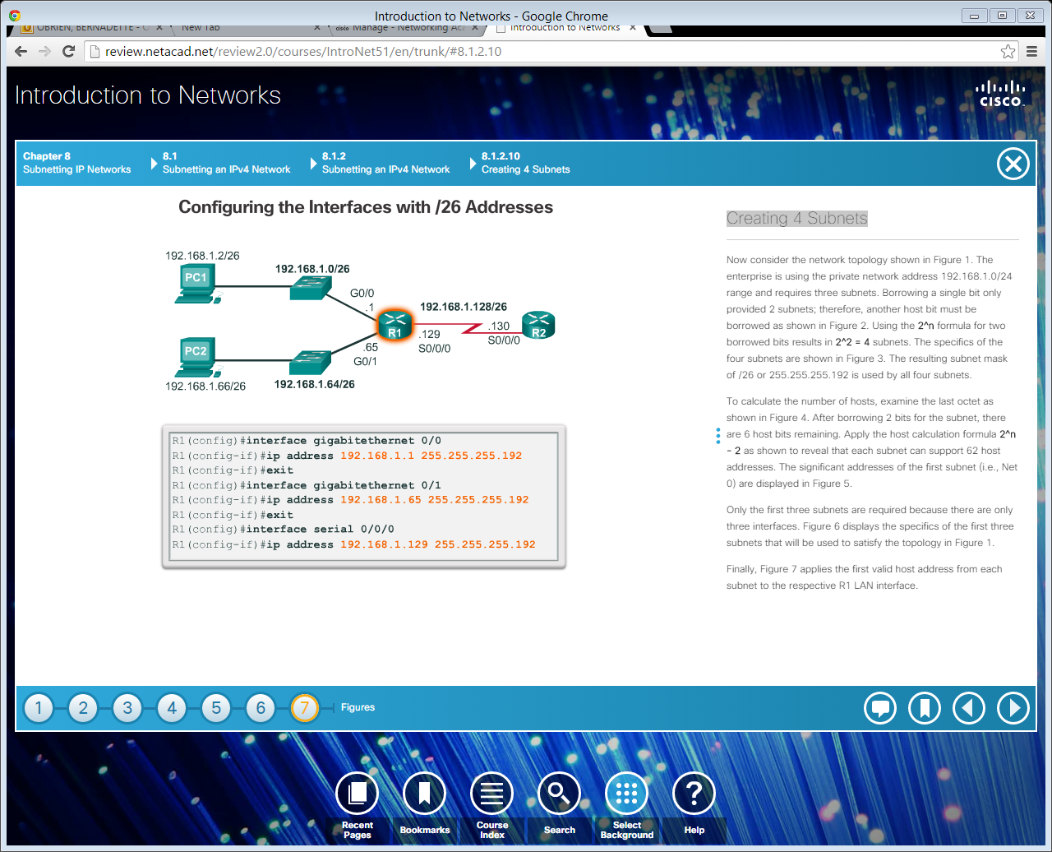
Creating 4 Subnets (cont.)
Notes:
8.1.2.10 Creating 4 Subnets (Cont.)
8.1.2.11 Video Demonstration – Creating Four Equal-Sized Subnets
8.1.2.12 Video Demonstration – Creating Eight Equal-Sized Subnets

Slide 29
Topic 8.1.3: Subnetting a /16 and a /8 Prefix

Slide 30
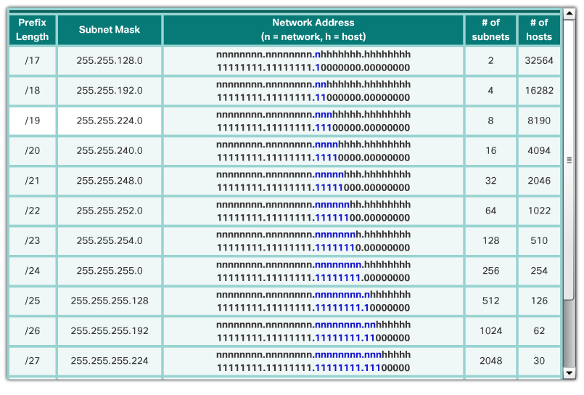
Creating Subnets with a /16 prefix
Notes:
8.1.3.1 Creating Subnets with a /16 prefix

Slide 31
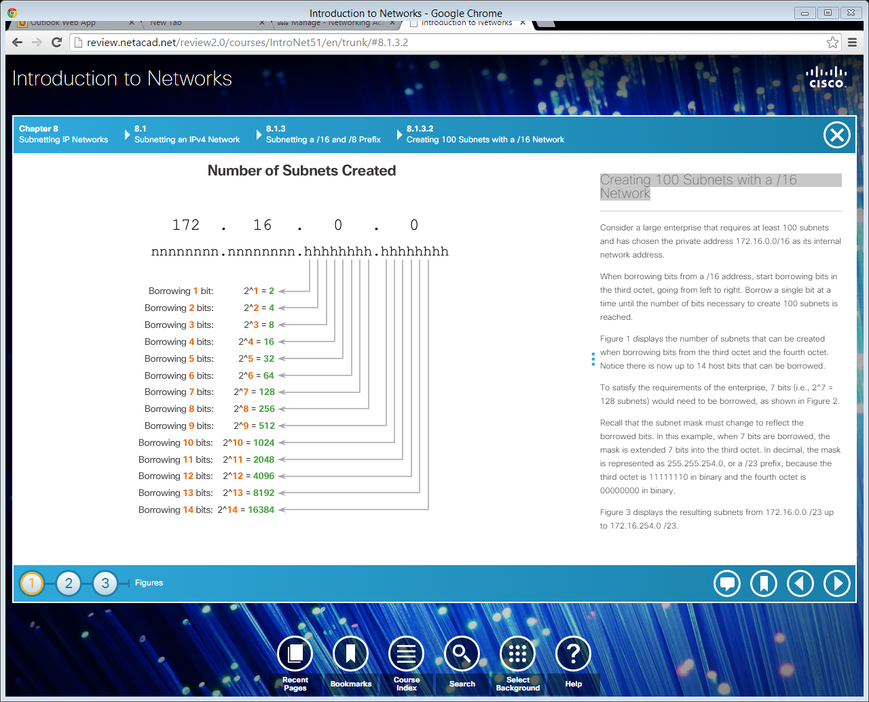
Creating 100 Subnets with a /16 Network
Notes:
8.1.3.2 Creating 100 Subnets with a /16 Network

Slide 32
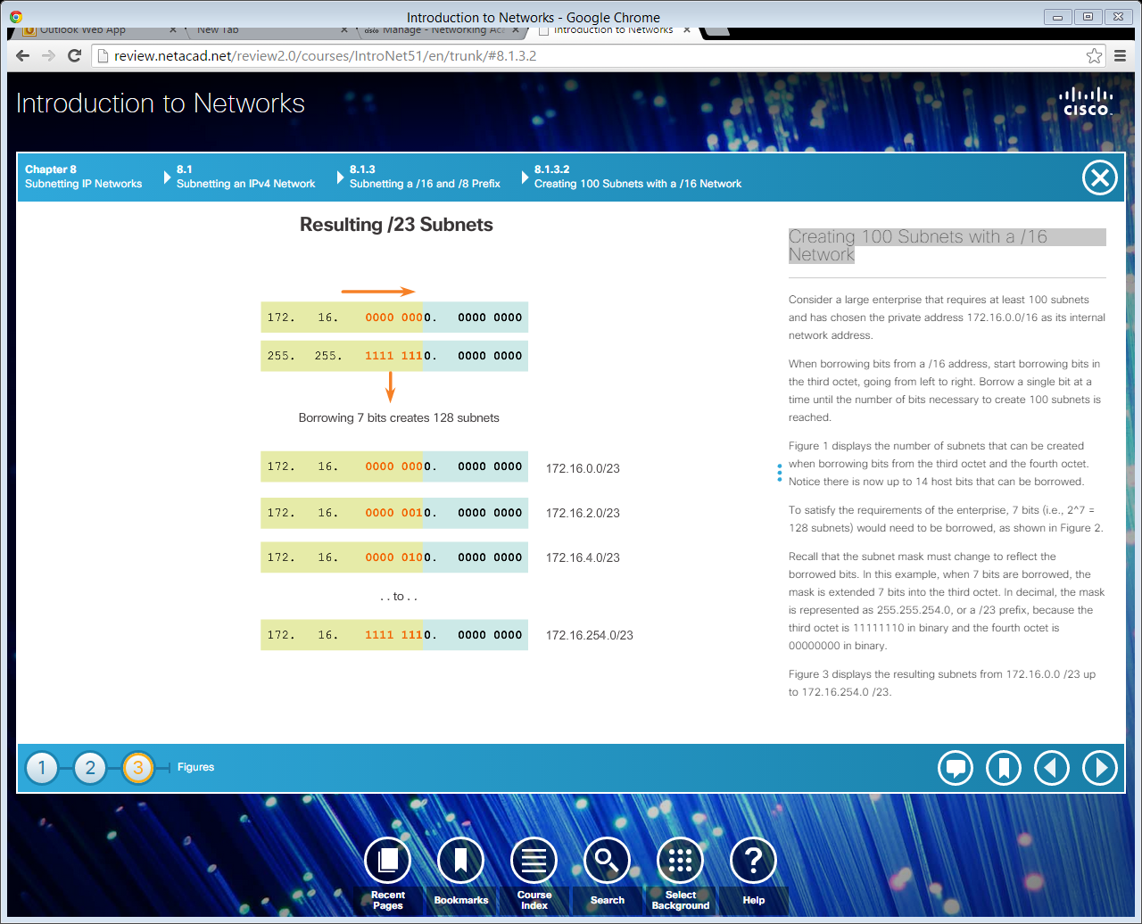
Creating 100 Subnets with a /16 Network (cont.)
Notes:
8.1.3.2 Creating 100 Subnets with a /16 Network

Slide 33
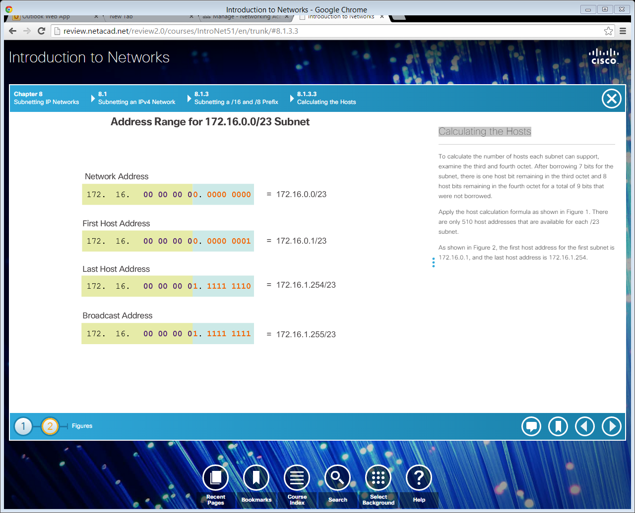
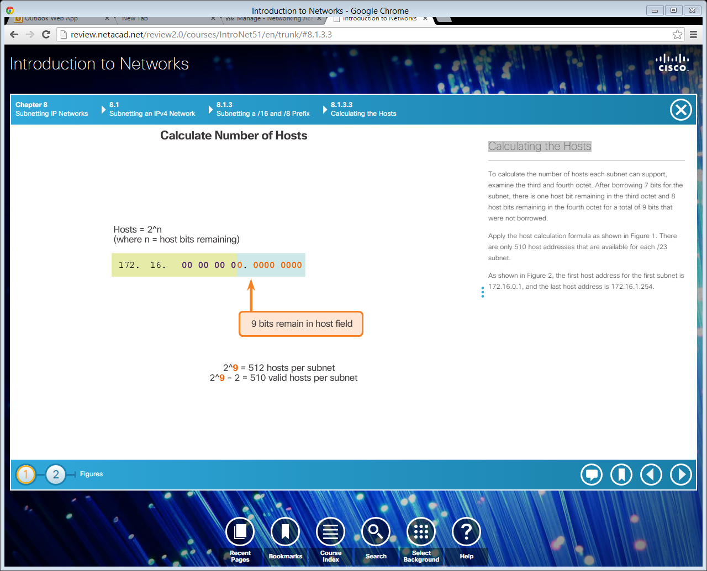
Calculating the Hosts
Notes:
8.1.3.3 Calculating the Hosts
8.1.3.4 Video Demonstration – Creating One Hundred Equal-Sized Subnets

Slide 34
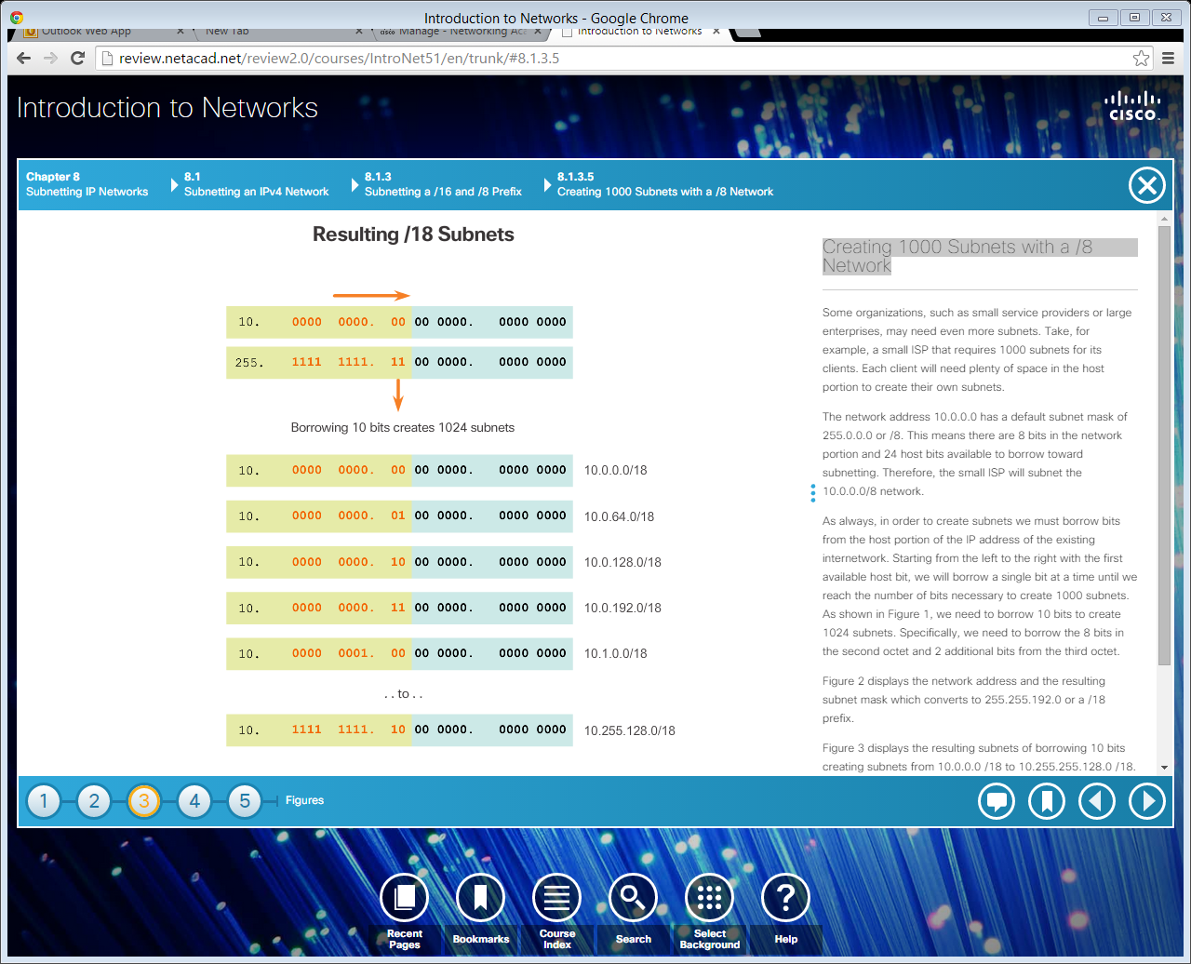
Creating 1000 Subnets with a /8 Network
Notes:
8.1.3.5 Creating 1000 Subnets with a /8 Network

Slide 35
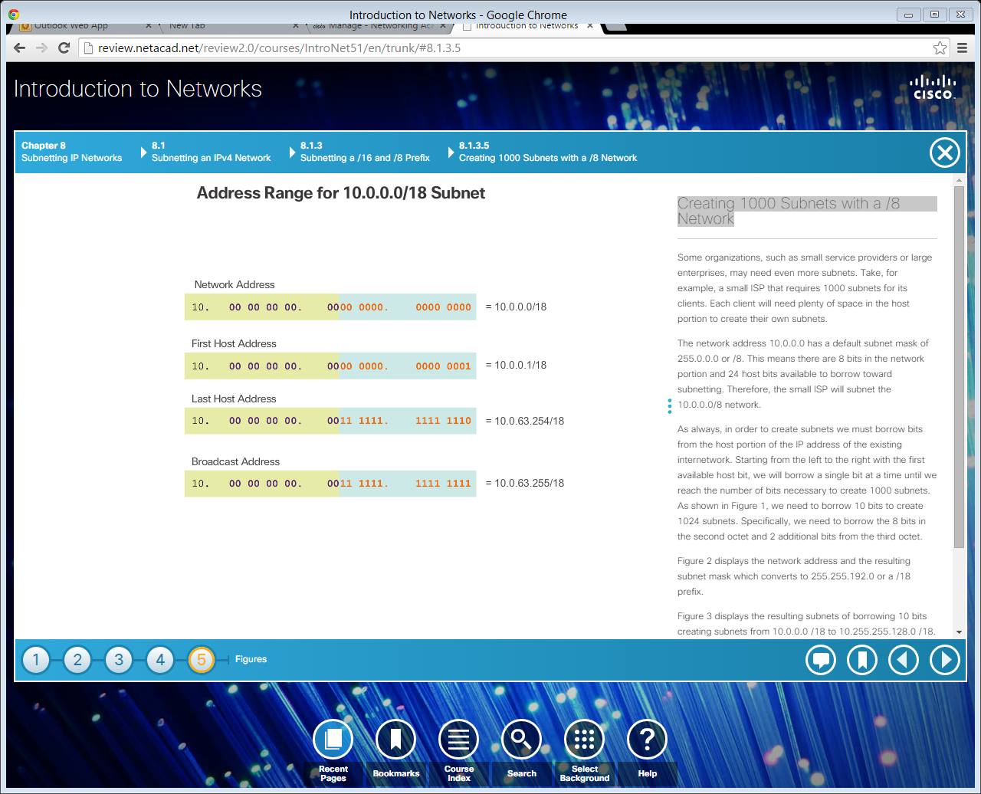
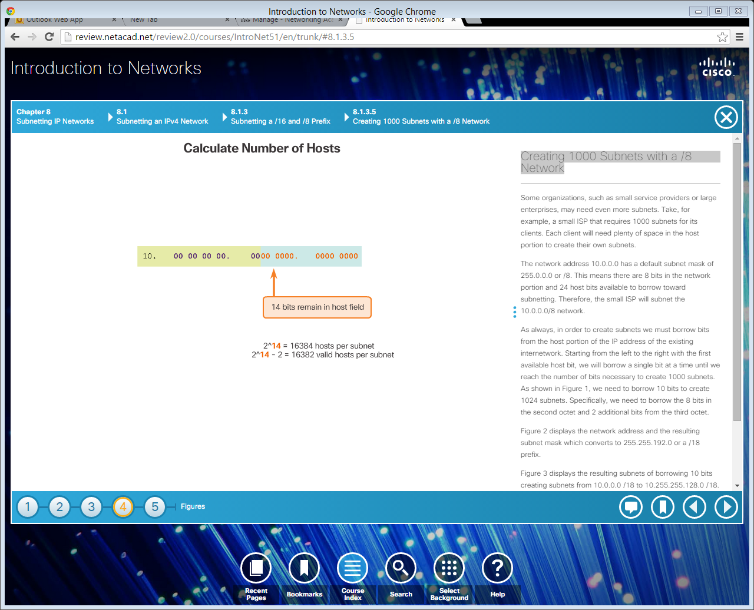
Creating 1000 Subnets with a /8 Network (cont.)
Calculating Hosts
Notes:
8.1.3.5 Creating 1000 Subnets with a /8 Network (Cont.)
8.1.3.6 Video Demonstration – Subnetting Across Multiple Octets

Slide 36
Topic 8.1.4: Subnetting to Meet Requirements

Slide 37
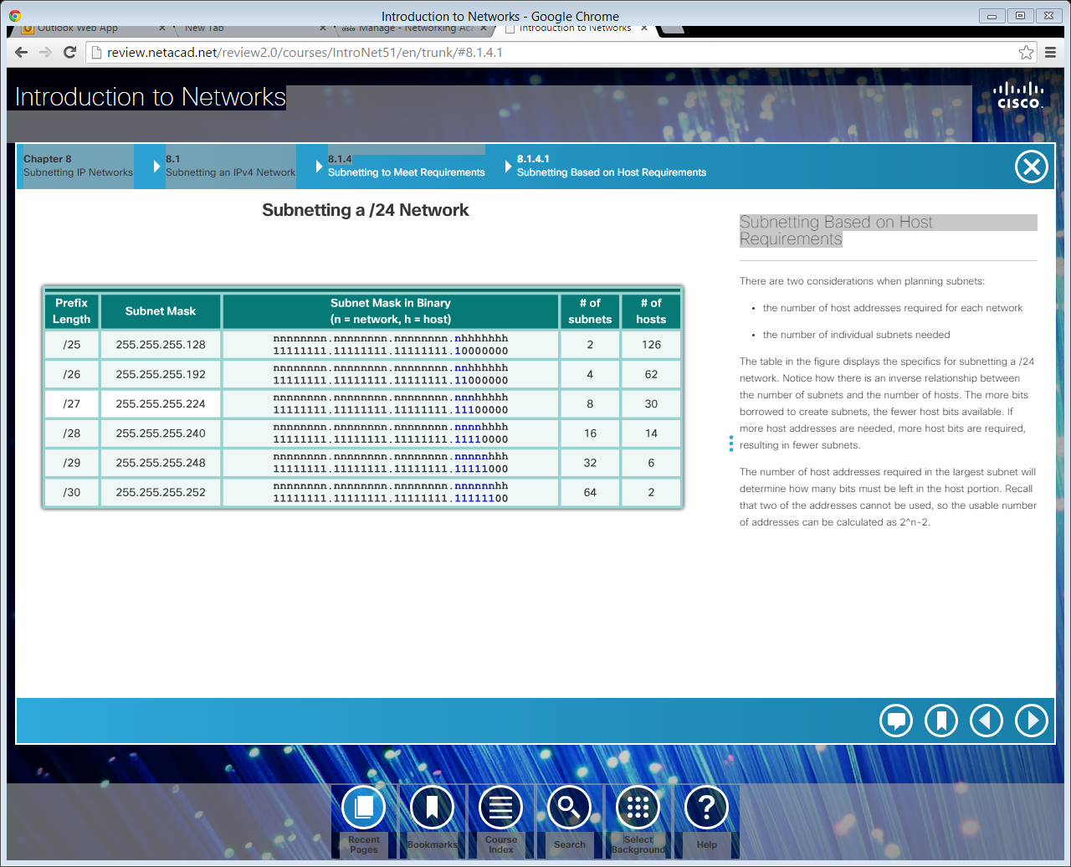
Subnetting Based on Host Requirements
Two considerations when planning subnets:
The number of host addresses required for each network.
The number of individual subnets needed.
The more bits borrowed to create subnets, the fewer host bits available.
Notes:
8.1.4.1 Subnetting Based on Host Requirements

Slide 38
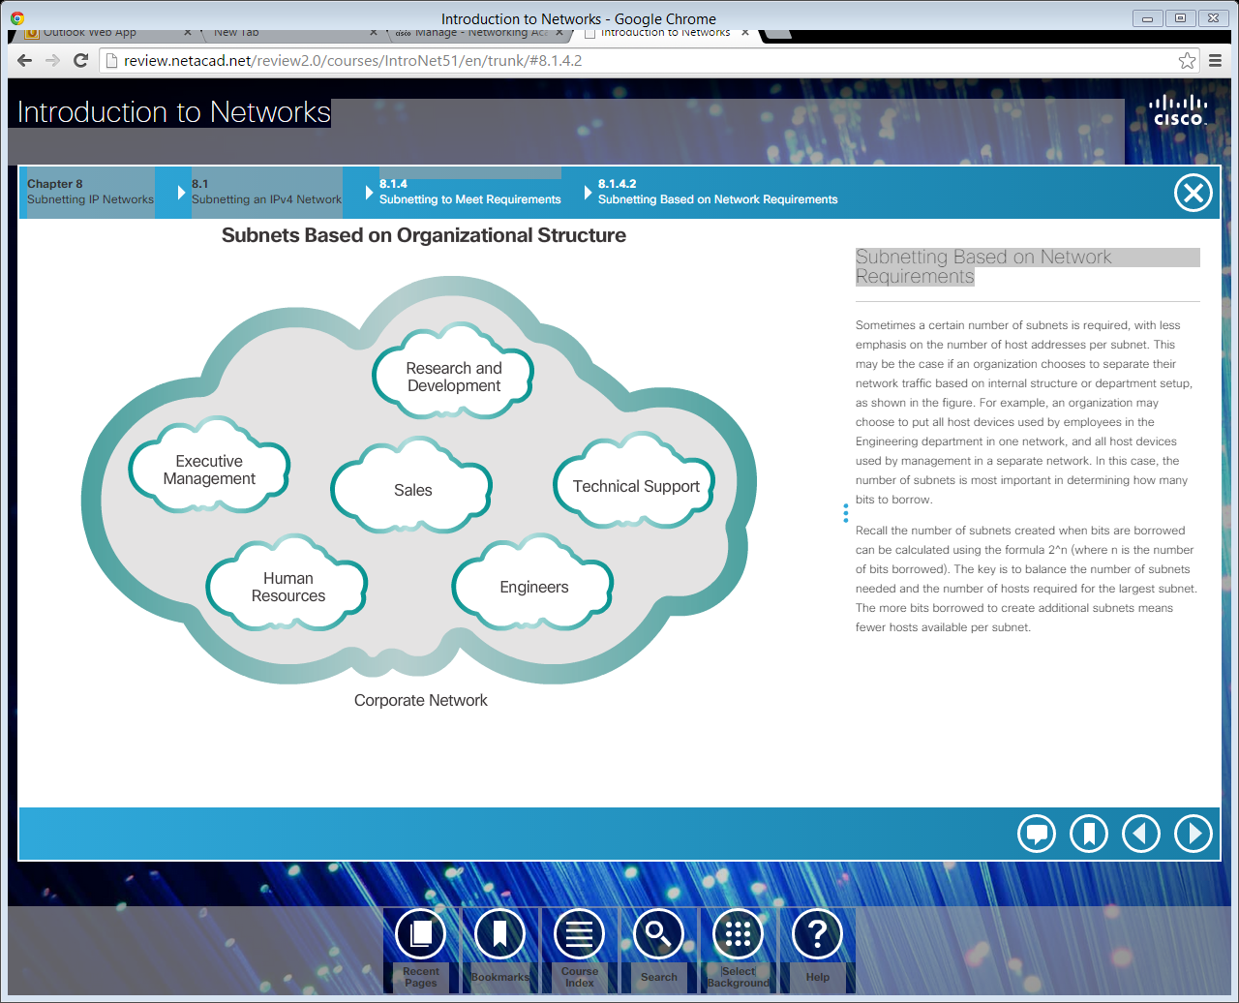
Subnetting Based on Network Requirements
Notes:
8.1.4.2 Subnetting Based on Network Requirements

Slide 39
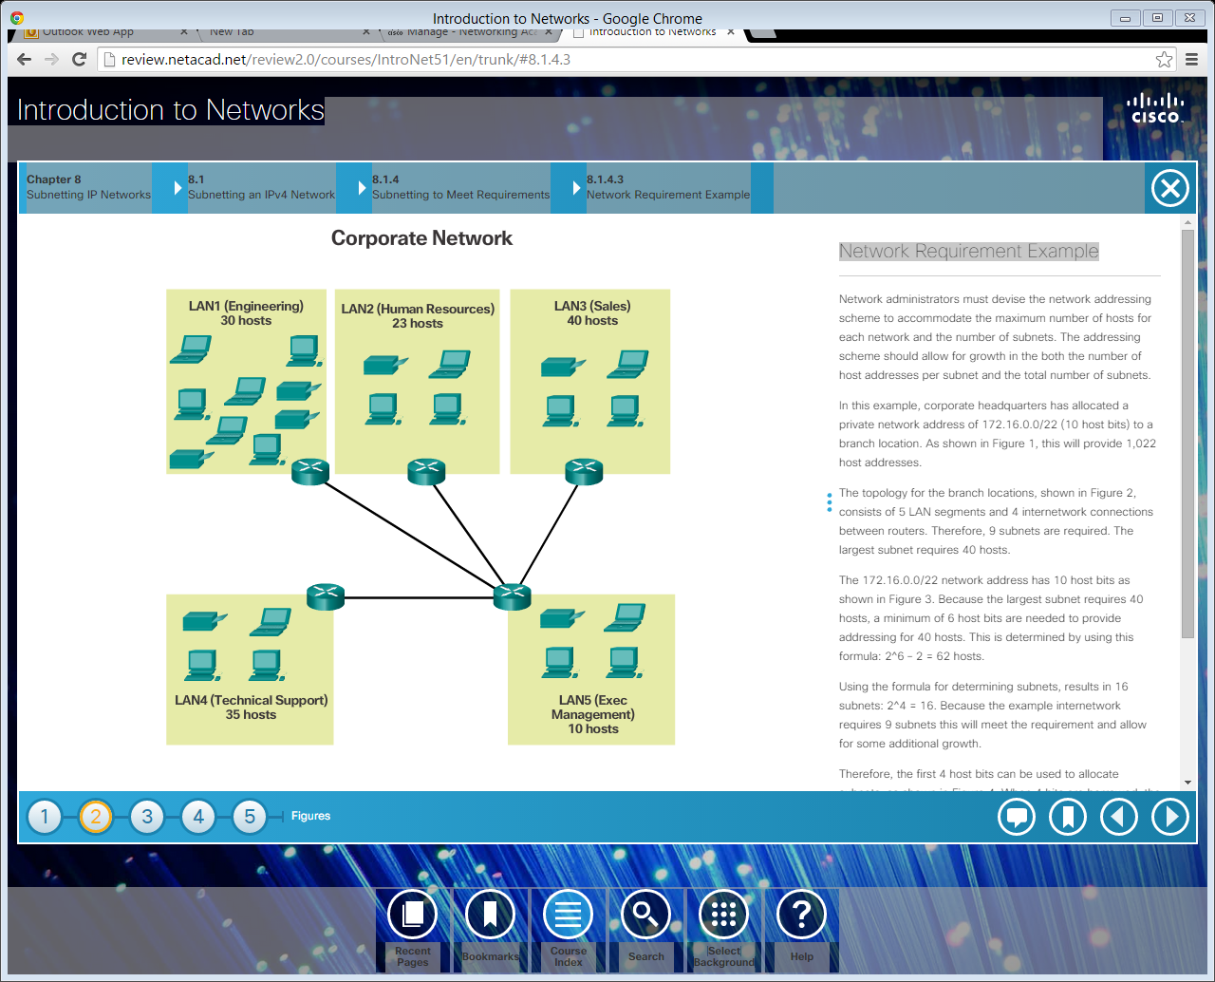
Network Requirement Example
Notes:
8.1.4.3 Network Requirement Example

Slide 40
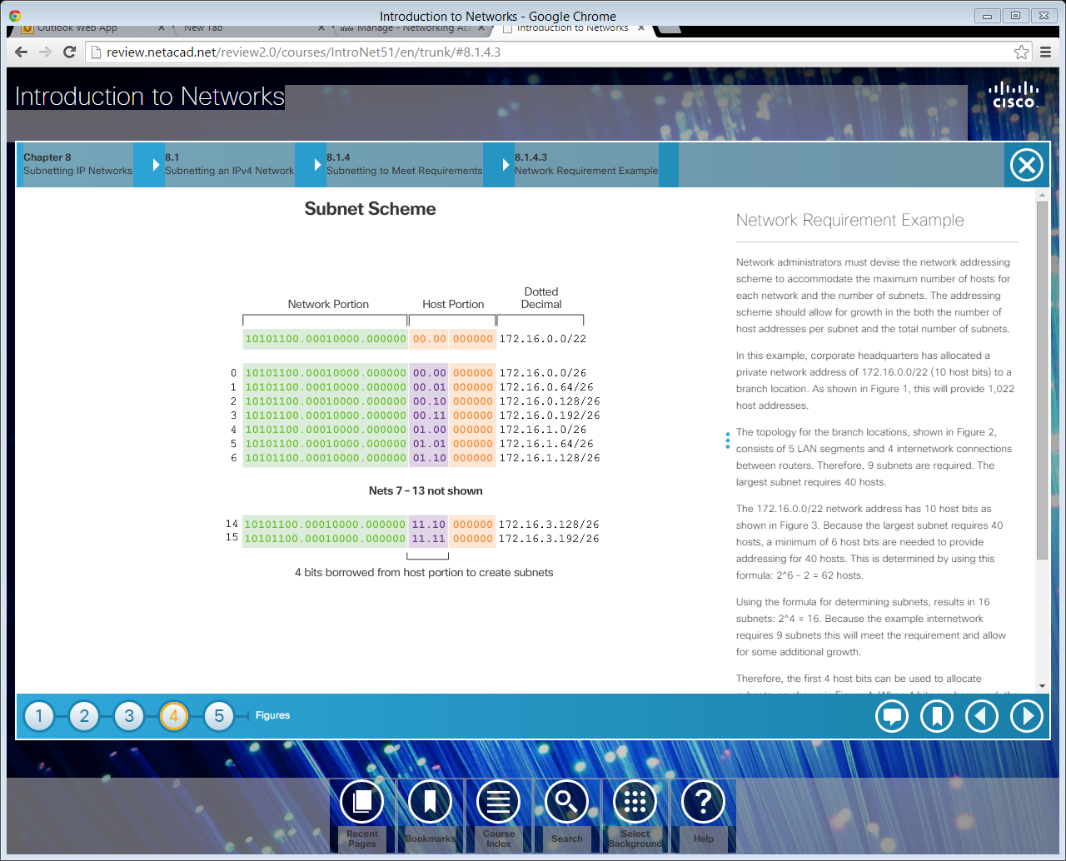
Network Requirement Example (cont.)
Notes:
8.1.4.3 Network Requirement Example (Cont.)

Slide 41
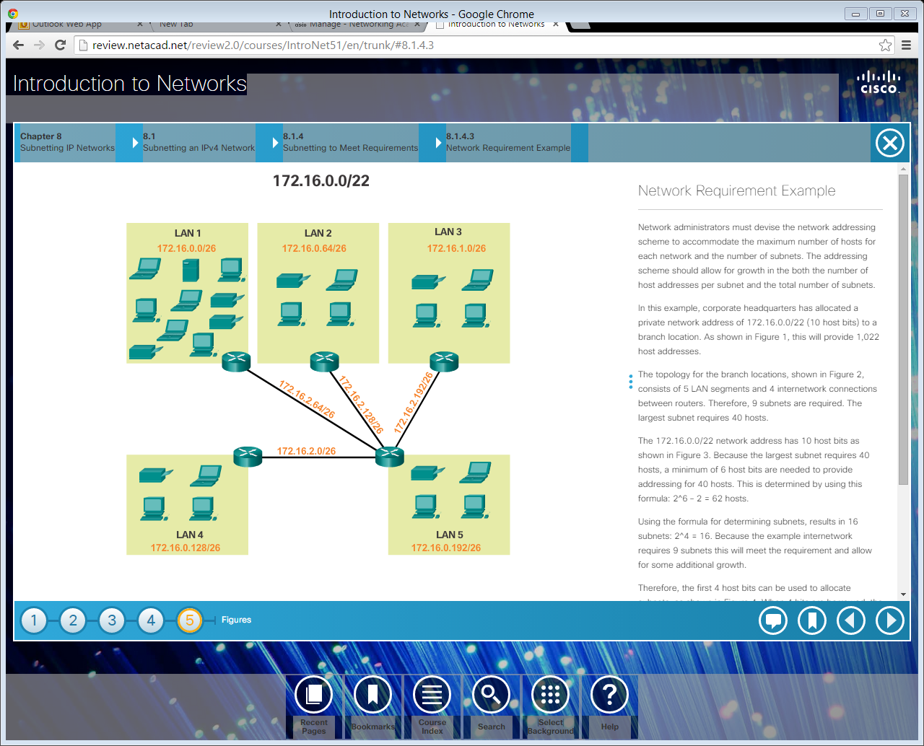
Network Requirement Example (cont.)
Notes:
8.1.4.3 Network Requirement Example (Cont.)
8.1.4.4 Activity – Calculate the Subnet Mask
8.1.4.5 Activity – Determining the Number of Bits to Borrow
8.1.4.6 Lab - Calculating IPv4 Subnets
8.1.4.7 Packet Tracer - Subnetting Scenario 1
8.1.4.8 Lab – Designing and Implementing a Subnetted IPv4 Addressing Scheme

Slide 42
Topic 8.1.5: Benefits of Variable Length Subnetting Masking

Slide 43
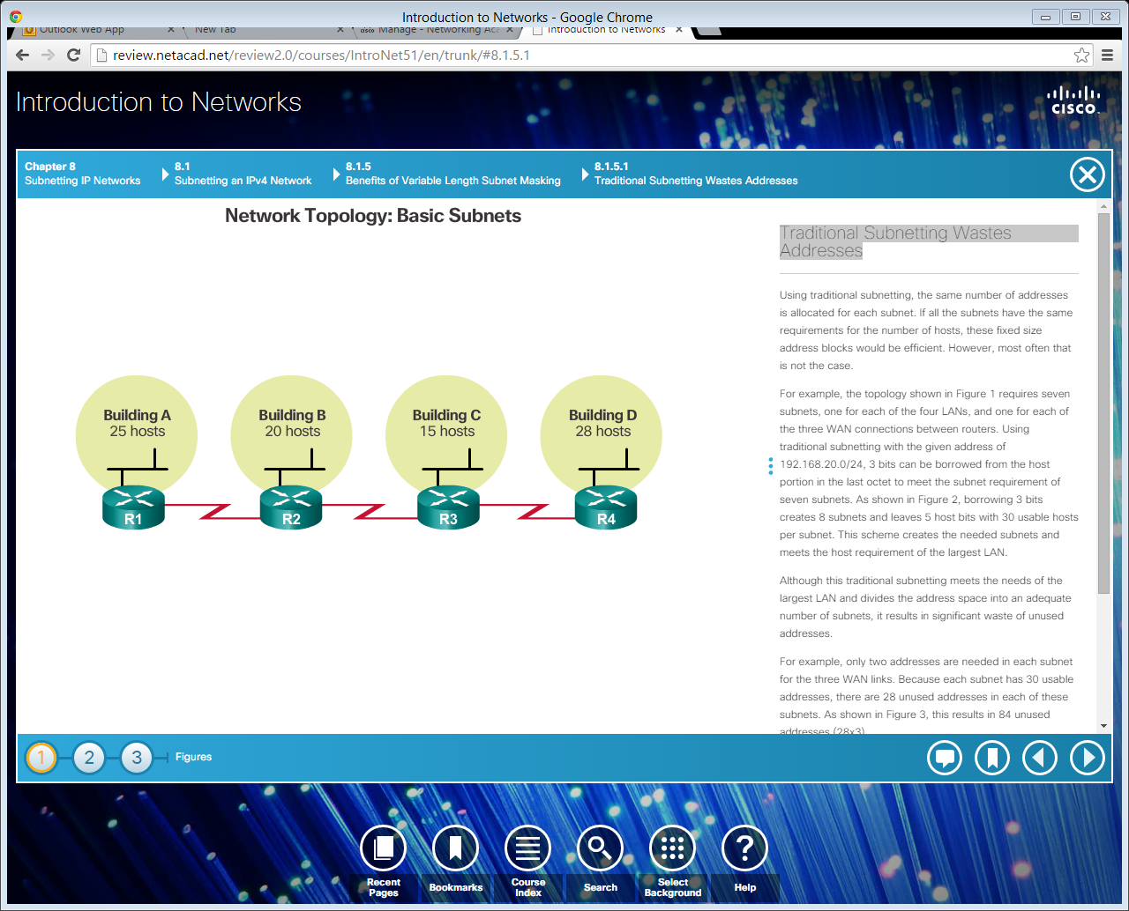
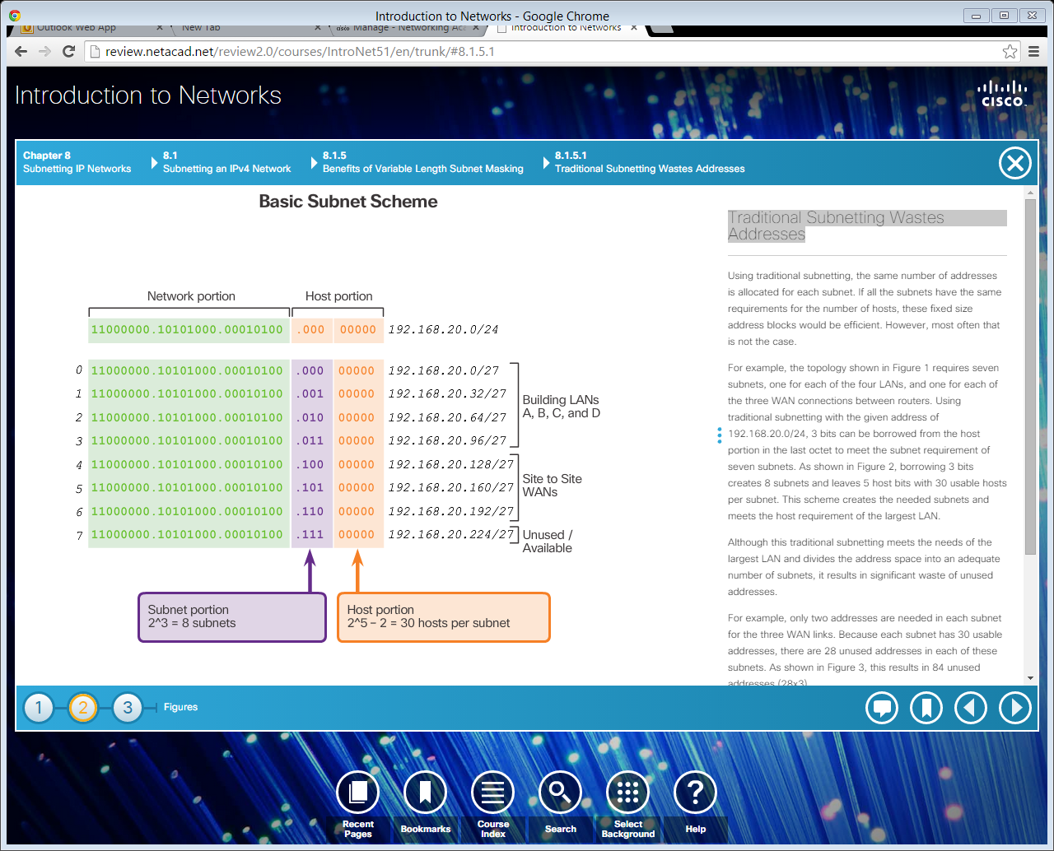
Traditional Subnetting Wastes Addresses
Notes:
8.1.5.1 Traditional Subnetting Wastes Addresses

Slide 44
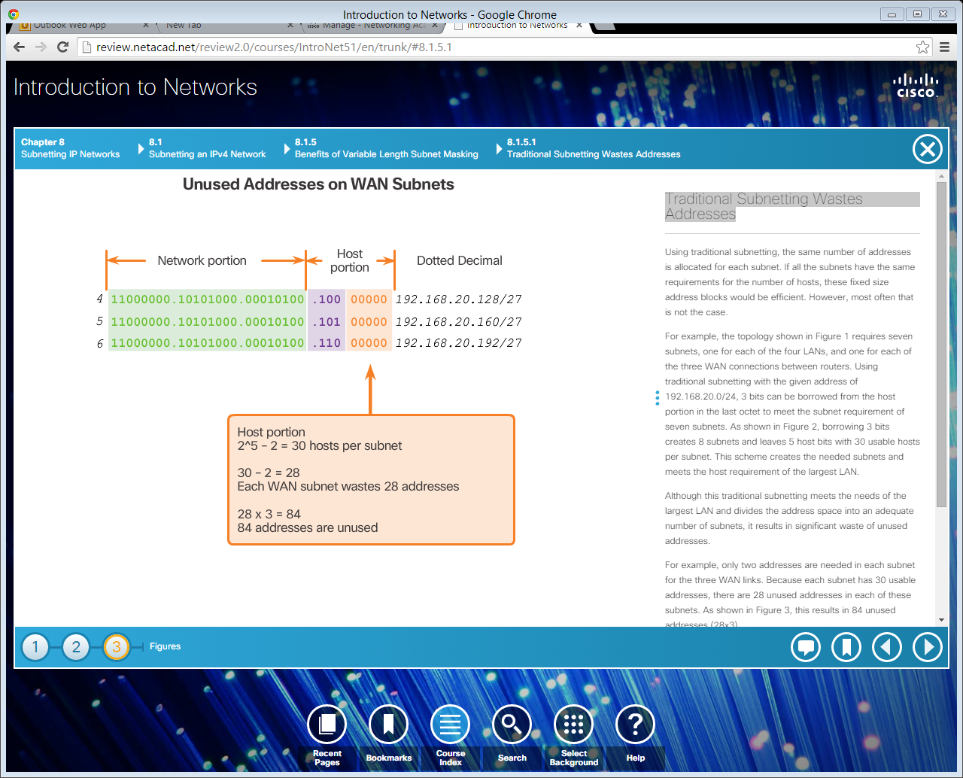
Traditional Subnetting Wastes Addresses (Cont.)
Notes:
8.1.5.1 Traditional Subnetting Wastes Addresses (Cont.)

Slide 45
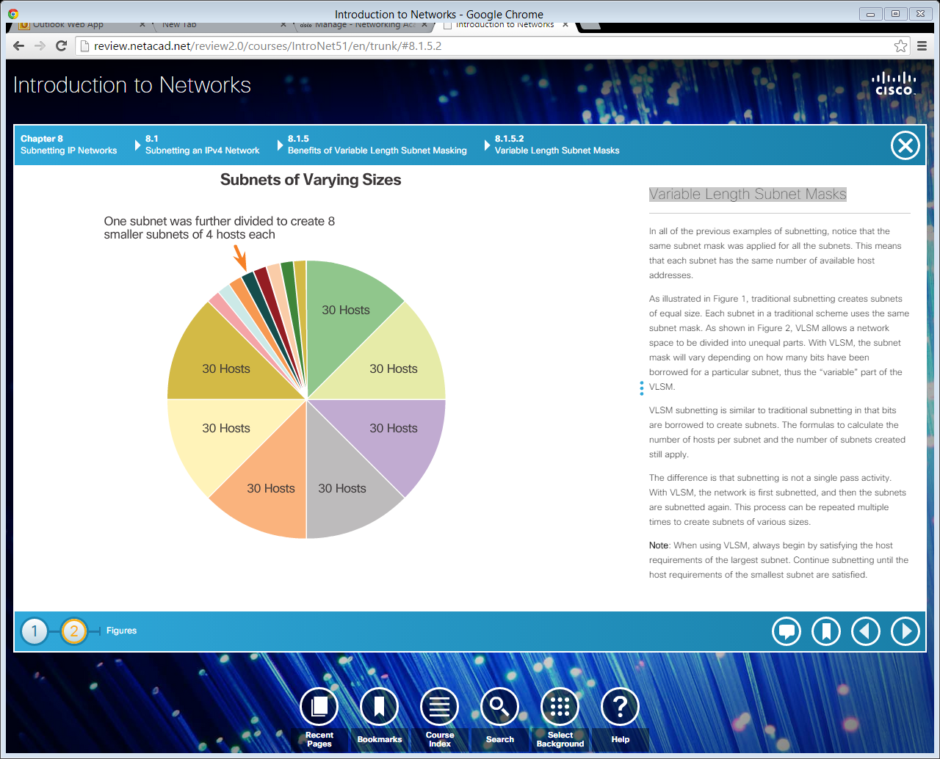
Variable Length Subnet Masks
Notes:
8.1.5.2 Variable Length Subnet Masks

Slide 46
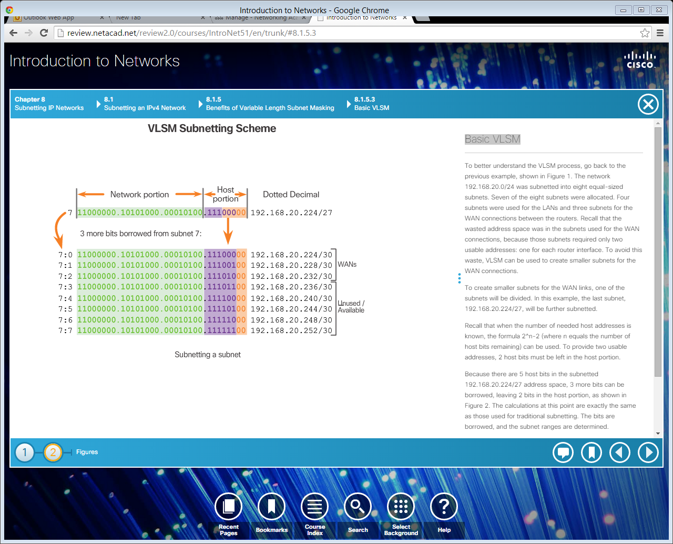
Basic VLSM
Notes:
8.1.5.3 Basic VLSM
8.1.5.4 Video Demonstration – Basic VLSM

Slide 47
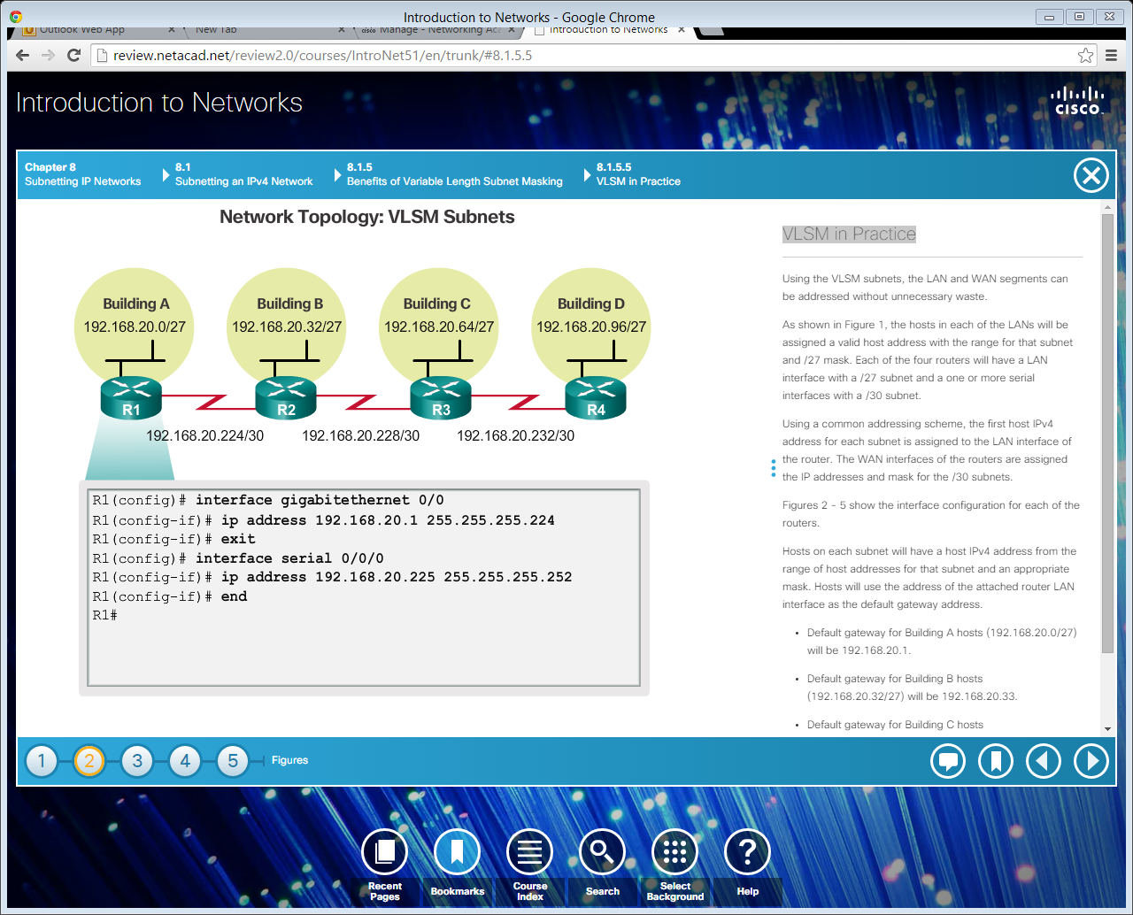
VLSM in Practice
Notes:
8.1.5.5 VLSM in Practice

Slide 48
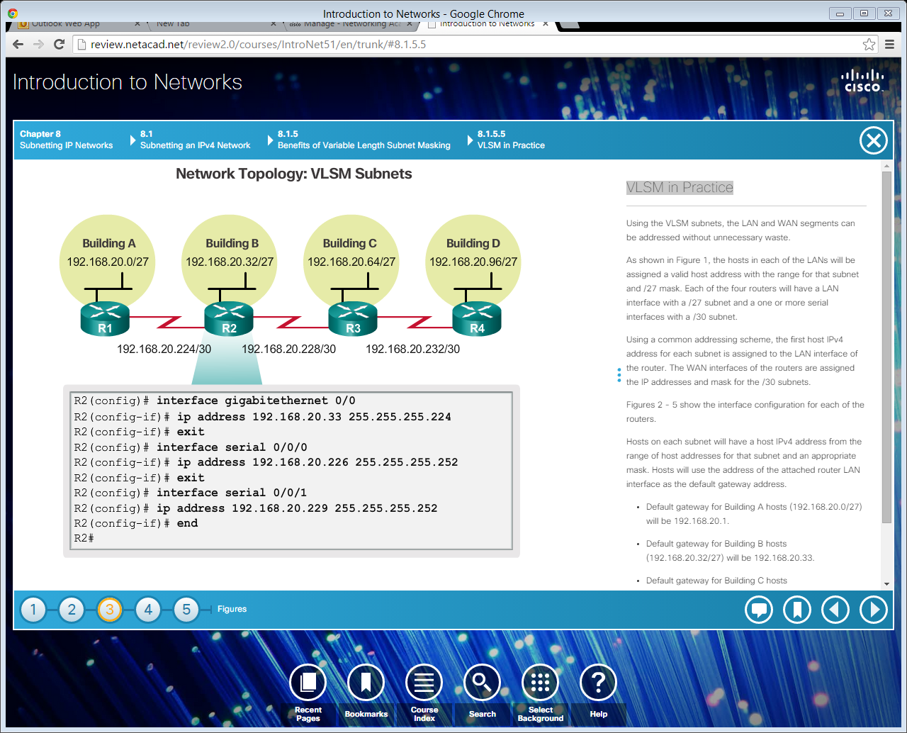
VLSM in Practice (cont.)
Notes:
8.1.5.5 VLSM in Practice (Cont.)

Slide 49

VLSM in Practice (cont.)
Notes:
8.1.5.5 VLSM in Practice (Cont.)

Slide 50
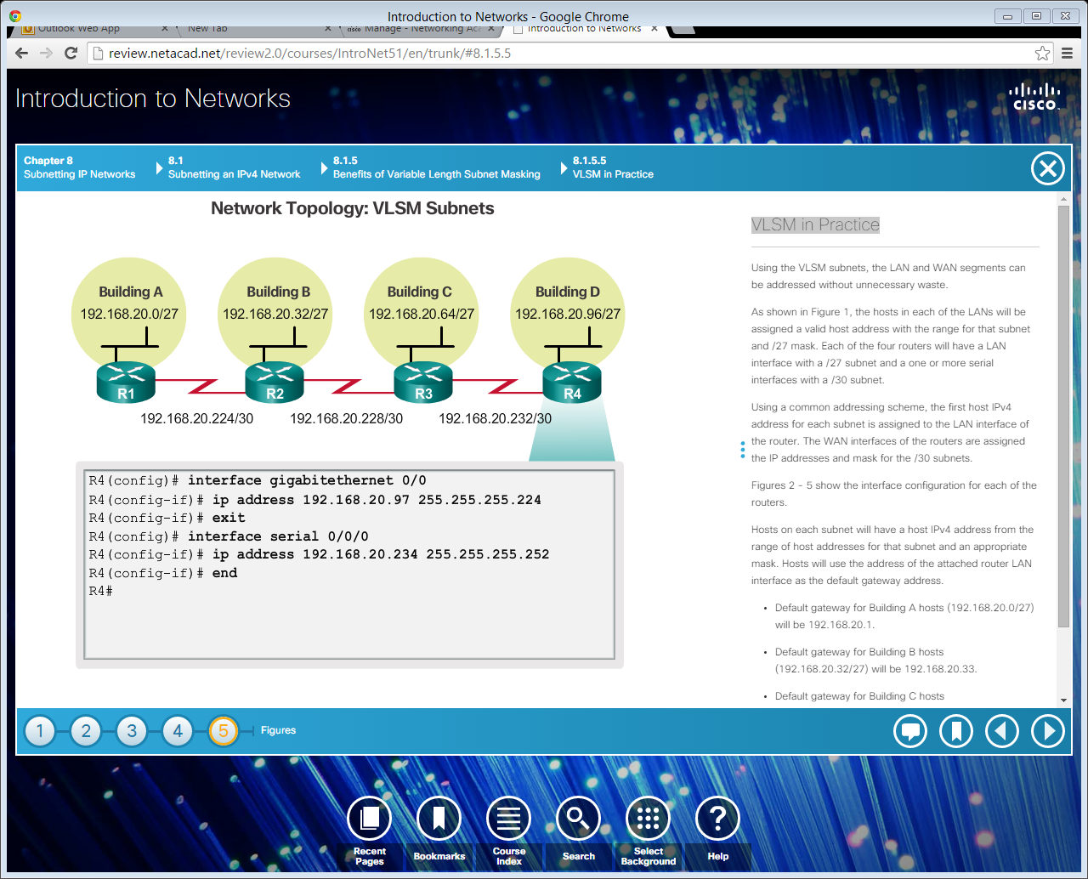
VLSM in Practice (Cont.)
Notes:
8.1.5.5 VLSM in Practice (Cont.)

Slide 51
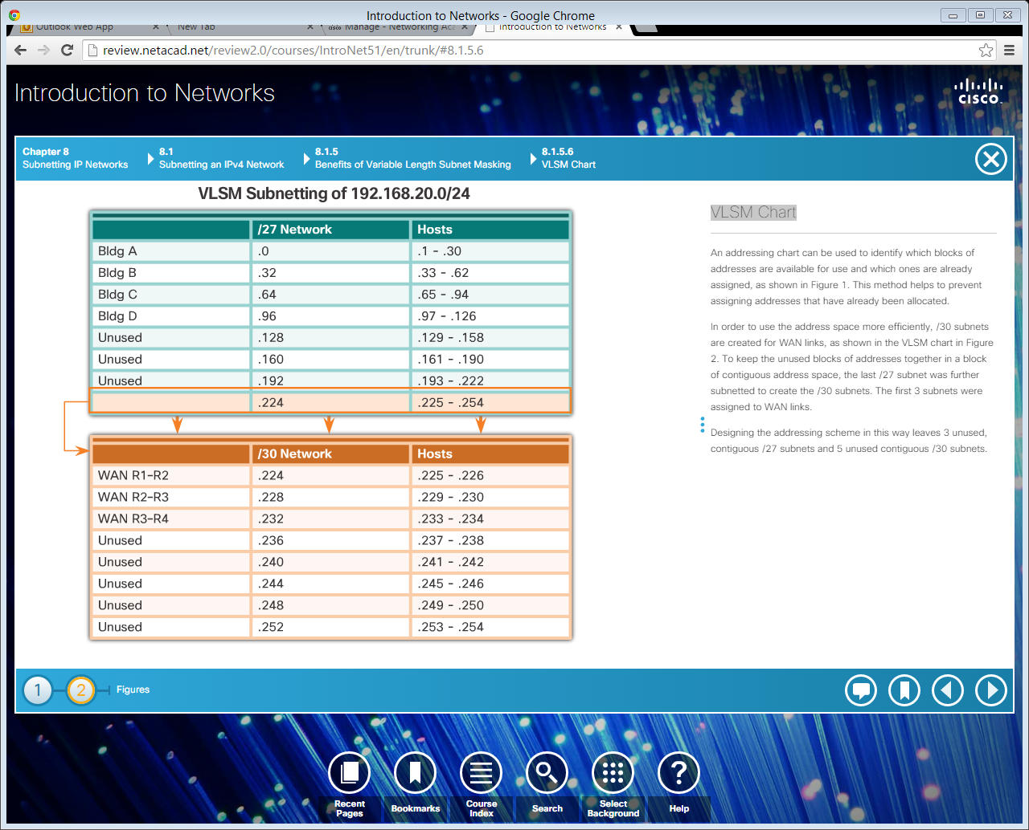
VLSM Chart
Notes:
8.1.5.6 VLSM Chart
8.1.5.7 Video Demonstration – VLSM Example
8.1.5.8 Activity – Practicing VLSM

Slide 52
Section 8.2: Addressing Schemes
Upon completion of this section, you should be able to:
Implement a VLSM addressing scheme.

Slide 53
Topic 8.2.1: Structured Design

Slide 54
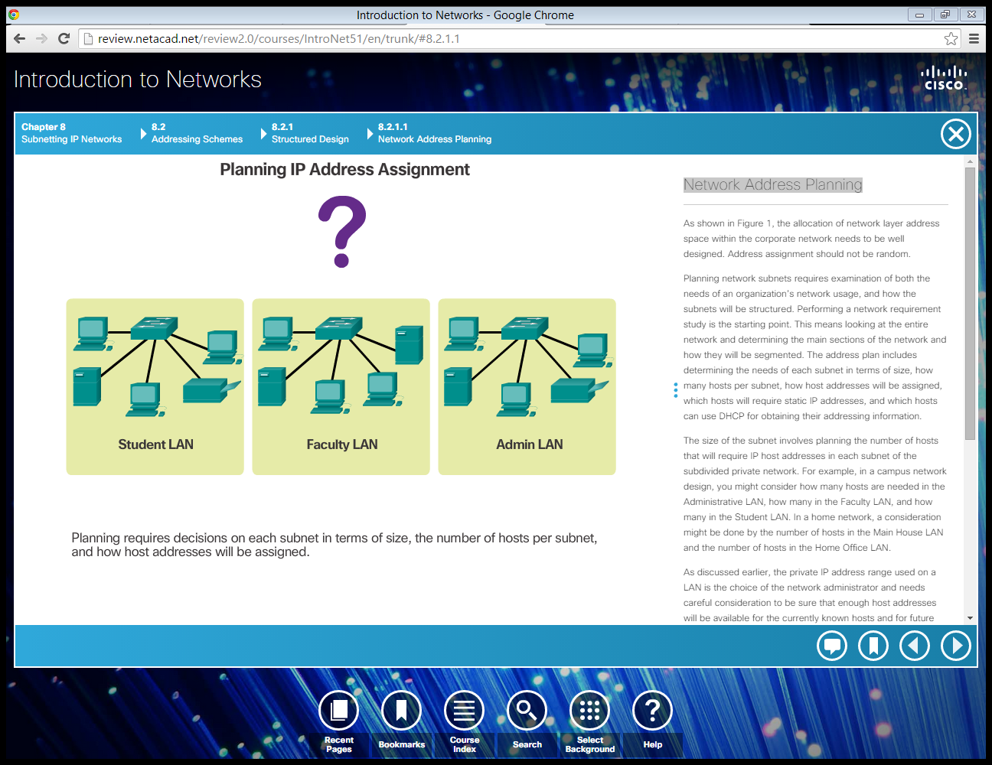
Network Address Planning
Notes:
8.2.1.1 Network Address Planning

Slide 55
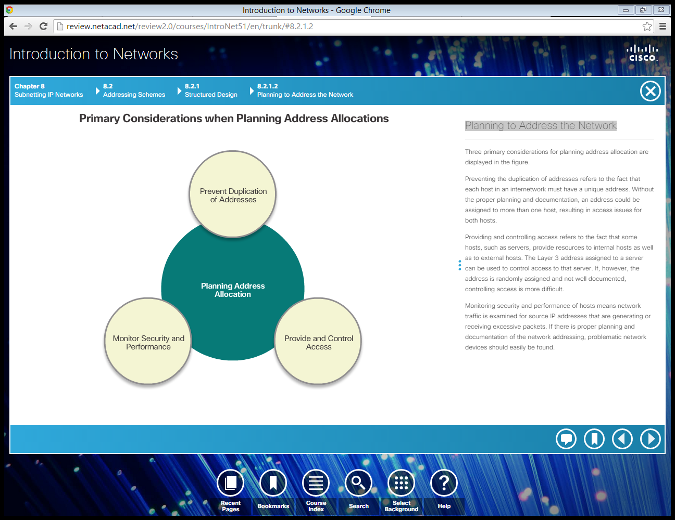
Planning to Address the Network
Notes:
8.2.1.2 Planning to Address the Network

Slide 56

Assigning Addresses to Devices
Notes:
8.2.1.3 Assigning Addresses to Devices
8.2.1.4 Packet Tracer – Designing and Implementing a VLSM Addressing Scheme
8.2.1.5 Lab – Designing and Implementing a VLSM Addressing Scheme

Slide 57
Section 8.3: Summary
Chapter Objectives:
Implement an IPv4 addressing scheme to enable end-to-end connectivity in a small to medium-sized business network.
Given a set of requirements, implement a VLSM addressing scheme to provide connectivity to end users in a small to medium-sized network.
Explain design considerations for implementing IPv6 in a business network.
Notes:
8.4.1.1 Class Activity – Can you call me now?
8.4.1.2 Packet Tracer – Skills Integration Challenge
8.4.1.3 Chapter 8: Subnetting IP Networks

